Slide 1
MEETING ROLES | THIS SLIDE IS HIDDEN.
Slide | Presenter/facilitator | Timing
Slide 2/Meeting kickoff *Includes roll call | Co-chairs: Councilmember Glaros & Ms. Alexander | 15 minutes (including time for people to come online if needed)
Slides 3-10 | Laura Searfoss | 10 minutes
Slides 11-29 | Laura Searfoss (11-14 / 15-18) David Huaman (19-25) Melissa Bondi (26-29) | 40 minutes total ~30 minutes for presentation ~10 minutes for Q&A
Slides 30-32 | Laura Searfoss (large-group facilitator) | 55 minutes total
Slides 33-36 | Laura Searfoss Co-chairs to close out with any remarks | 5 minutes
Additional meeting roles:
Slide deck screenshare: Charlotte (PGC)
Electronic notetaker: Sam

Slide 2


HOUSING OPPORTUNITIES FOR ALL WORKGROUP
PRINCE GEORGE’S COUNTY FRIDAY, DECEMBER 11, 2020

Slide 3
MEETING OVERVIEW & OBJECTIVES

Slide 4
AGENDA
TODAY’S AGENDA
Welcome from co-chairs and roll call
Meeting overview & objectives
Presentation: Draft Workgroup recommendations: Actions to support tenants
Open dialogue on proposed recommendations: Impressions & feedback
Next steps & wrap-up
Adjourn

Slide 5
MEETING PURPOSE
TODAY’S AGENDA
By the end of this meeting, we will have…
A shared understanding of the recommended actions for the workgroup’s annual report
A list of critical changes or edits to help finalize the recommendations prior to submission

Slide 6
Q&A FOR GENERAL PUBLIC
TODAY’S AGENDA
This meeting is being live-streamed to Prince George’s County residents.
SUBMIT YOUR QUESTIONS If you are watching the live stream and would like to submit a question during the meeting, here’s how to share your question with the organizers: Use this link to submit your question.
This link can also be accessed using the following steps: GO TO: www.menti.com ENTER CODE: 22 40 20 6

Slide 7
WORKGROUP ACTIVITIES SEPTEMBER-NOVEMBER 2020
RECAP
ADAPTED TO CHANGING NEEDS
MEETINGS
RECOMMENDATIONS
Highlighted emerging or exacerbated housing needs related to COVID-19.
Met five times.
Prioritized actions related to supporting tenants.
Focused on preparing for expiring tenant protections and creating permanent solutions.
Gathered on-the-ground perspectives.
Used consensus-based decision-making.
Adapted to remote meeting format.
Notes:
We’ve been building toward these recommendations since we started meeting in September – in that time, we’ve been mining your experiences about how COVID-19 is affecting County residents and working to prioritize specific actions.
A key focus of our past discussions is how to prepare for the anticipated impact of expiring eviction moratoria, which could leave many tenants facing evictions and housing instability as early as January 1.

Slide 8
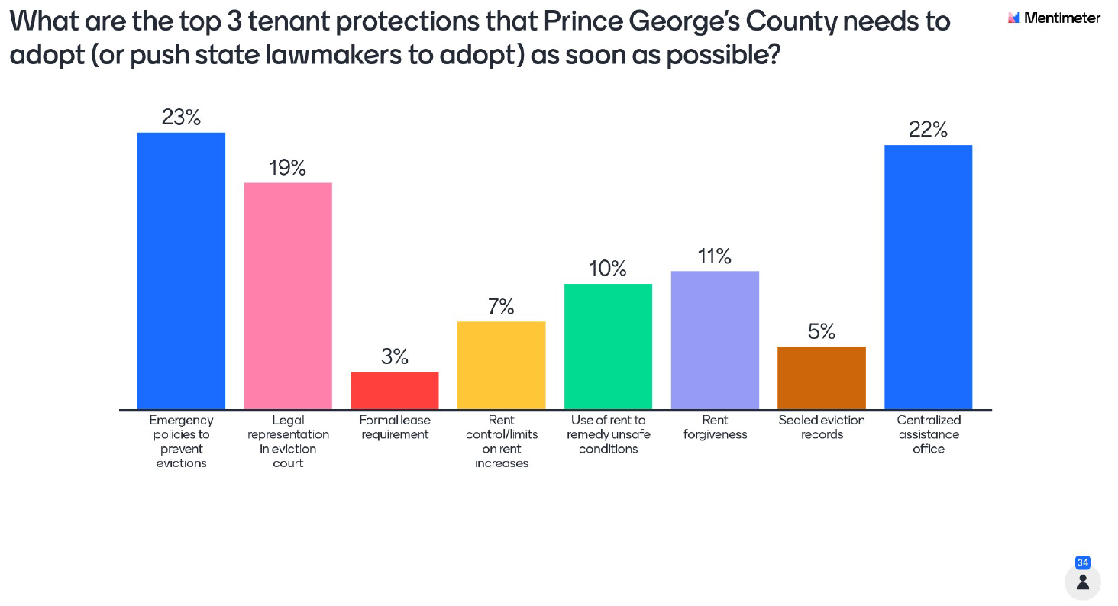
WHAT WE HEARD SEPTEMBER-NOVEMBER 2020
RECAP
PRIORITIES: TENANT PROTECTIONS
Emergency policies to prevent evictions
Centralized tenant office
Legal representation in eviction court
Notes:
With that focus in mind, we brainstormed different ways to support tenants and at our last meeting in November, meeting participants ranked potential actions related to expanded tenant protections and information and outreach to tenants.
This slide shows the results of the ranking related to tenant protections.
The top ranked actions were:
Emergency policies to prevent evictions
Centralized tenant office
Legal representation in eviction court

Slide 9
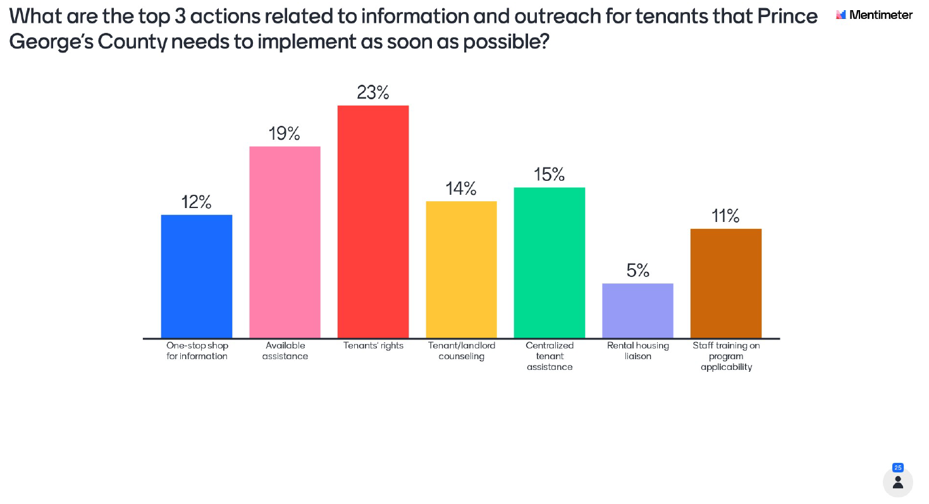
WHAT WE HEARD SEPTEMBER-NOVEMBER 2020
RECAP
PRIORITIES: INFORMATION & OUTREACH
Tenants’ rights
Available assistance
Centralized tenant assistance
Notes:
This slide shows the results of the ranking related to information and outreach for tenants.
The top ranked actions were:
Information and outreach related to tenants’ rights
Information and outreach related to available assistance
And having centralized tenant assistance to guide people seeking assistance through the various programs

Slide 10
WHAT WE HEARD SEPTEMBER-NOVEMBER 2020
RECAP
COMMON THEMES ACROSS SOLUTIONS
Urgency, specifically the growing concern about the anticipated effects of expiring CDC and State of Maryland’s eviction moratoria on tenants and landlords
Permanence, such as making temporary renter support programs and resources into permanent programs offered by the County
Flexibility, by lowering barriers to access and use, with attention to providing resources to people regardless of immigration status or existing arrears
Strong outreach, with special attention to multi-lingual outreach
More housing affordability, including vouchers and innovative models of housing such as community land trusts and county-run housing
Notes:
Beyond specific actions, there were some common themes about solutions that came up in our discussion:
The first one was urgency – specifically getting organized to address the anticipated impact of expiring tenant protections.
The second was permanence – your comments highlighted the opportunity to make temporary renter support programs, like the County’s Emergency Rental Assistance Program, into permanent ones over time.
The third one was flexibility – we heard a lot of comments from you about some of the barriers to using existing programs and that solutions going forward need to be as low-barrier and culturally relevant as possible.
The next theme centered on strong outreach – including outreach in multiple languages – with outreach incorporated into any solution that moves forward and the importance of strong outreach in achieving impact.
And finally, there were a lot of comments about the need to continue to create more housing affordability – in part as a way to build resilience over time.

Slide 11
OVERVIEW PROPOSED WORKGROUP RECOMMENDATIONS TO COUNTY COUNCIL & EXECUTIVE

Slide 12
RECOMMENDATIONS RELATIONSHIP TO CHS
PROPOSED WORKGROUP RECOMMENDATIONS: OVERVIEW
THE RECOMMENDATIONS ADVANCE THE FOLLOWING ACTIONS FROM HOUSING OPPORTUNITY FOR ALL:
CROSS-CUTTING ACTION 1.4 Strengthen rights and responsibilities of tenants and landlords.
CROSS-CUTTING ACTION 2.9 Build a fully culturally competent staff to serve the County’s changing demographics.
TARGETED ACTION 2.4 Create a range of resources for households experiencing a housing crisis.
Notes:
To start, I wanted to highlight that jumping off for the recommendations we’re going to be reviewing and discussing for the remainder of today’s meeting is Housing Opportunity for All.
Specifically, the recommendations advance three actions from the County’s comprehensive housing strategy:
Crosscutting Action 1.4, which aims to create stronger rights from tenants and landlords
Cross-cutting Action 2.9, which focuses on building more cultural competence within the County (both in government and among partners)
Targeted Action 2.4, which focuses on creating more resources for households experiencing a housing crisis.

Slide 13
RECOMMENDATIONS OVERVIEW BY TYPE
PROPOSED WORKGROUP RECOMMENDATIONS: OVERVIEW
Recommended action | Type of action
 | Program | Policy | Budget
Support community resource navigators at local organizations. | ✓ | - | ✓
Conduct cross-departmental staff training on tenants’ rights and issues and how to make referrals. | ✓ | - | ✓
Establish a full-time tenant liaison position in County government. | ✓ | - | ✓
Expand emergency tenant protections through local legislation. | - | ✓ | -
Work to make emergency tenant protections in CB-16-2020 into permanent tenant protections. | - | ✓ | -
Establish a centralized tenant assistance office. | ✓ | - | ✓
Establish one-stop shop for tenant information. | ✓ | - | ✓
Address language barriers. | ✓ | - | ✓
Provide information and outreach through inclusive communication tactics. | ✓ | - | -
Allocate funding for a low-barrier housing assistance fund. | ✓ | - | ✓
Work to create a permanent housing assistance fund. | ✓ | - | ✓
Create a landlord tax credit or property tax waiver for rent and late fee/interest forgiveness. | ✓ | ✓ | ✓
Create a philanthropic pool of emergency assistance dollars for one-time tenant needs. | ✓ | - | -
Notes:
Here are the recommendations – which we will review in more detail in a bit – organized by action type.
Broadly, these actions fall into at least one of three categories:
Programmatic – which are actions that affect County programs (either existing ones or creation of new ones)
Policy – which are actions that are implemented through legislative changes
Budget - which are actions that require funding or have some other type of budget impact (administrative costs; forgone tax revenue).
In general, most of the recommendations are programmatic and budget actions, as they are intended to create new resources for tenants.

Slide 14
RECOMMENDATIONS OVERVIEW BY IMPLEMENTATION TIMELINE
PROPOSED WORKGROUP RECOMMENDATIONS: OVERVIEW
Recommended action | Implementation timeline
 | 60-90 days | 90+days
Support community resource navigators at local organizations. | ✓ | -
Conduct cross-departmental staff training on tenants’ rights and issues and how to make referrals. | ✓ | ✓
Establish a full-time tenant liaison position in County government. | - | ✓
Expand emergency tenant protections through local legislation. | ✓ | -
Work to make emergency tenant protections in CB-16-2020 into permanent tenant protections. | - | ✓
Establish a centralized tenant assistance office for tenants. | - | ✓
Establish one-stop shop for tenant information. | ✓ | -
Address language barriers. | ✓ | ✓
Provide information and outreach through inclusive communication tactics. | ✓ | ✓
Allocate funding for a low-barrier housing assistance fund. | ✓ | -
Work to create a permanent housing assistance fund. | - | ✓
Create a landlord tax credit or property tax waiver for rent and late fee/interest forgiveness. | - | ✓
Create a philanthropic pool of emergency assistance dollars for one-time tenant needs. | ✓ | -
Notes:
Here are the recommendations organized by their primary implementation timeline.
Recommendations that fall into the 60-90-day timeframe are those intended to set-up supports in response to expiring tenant protections – and these should be considered priorities for implementation. Some of these recommendations have ongoing implementation steps (keeping information current; training on any changes to programs; etc.) to take after the initial 90-day window, which is why some of them are categorized in both the 60-90-day and 90+ day timeframes.
Recommendations that fall into the 90-day timeframe only are those intended to create longer term resources or more permanent changes to support tenants.
*Now we’ll move on to do a deep dive into each recommendation.

Slide 15
DEEP DIVE PROPOSED WORKGROUP RECOMMENDATIONS TO COUNTY COUNCIL & EXECUTIVE

Slide 16
SUPPORT COMMUNITY RESOURCE NAVIGATORS AT LOCAL ORGANIZATIONS.
PROPOSED WORKGROUP RECOMMENDATIONS: DEEP DIVE
IMPLEMENTATION CONSIDERATIONS
Core competencies among community resource navigators may include:
Strong relationship with affected tenants
Cultural understanding of and access to affected tenants (language, norms, power dynamics)
Knowledge of local resource landscape and tenant-landlord laws
ACTION TYPE(S): PROGRAM | BUDGET: $500,000 for ~5 NAVIGATOR POSITIONS (ESTIMATED)
60-90 DAY IMPLEMENTATION STEPS
Allocate public and philanthropic funding for grants for community resource navigators.
Solicit for community resource navigators for local organizations through competitive request for proposals.
Align information and outreach efforts with community resource navigators’ outreach.
90+ DAY IMPLEMENTATION STEPS
Monitor and report outcomes from use of community resource navigators.
Notes:
This action is intended to address the need for strong outreach, cultural relevance, and centralized assistance to tenants as they seek different types of resources.
Community resource navigators are XX.
This is an action that would require a funding to provide grants to local organizations – with a goal to get these positions funded within 60-90 days.

Slide 17
ESTABLISH A FULL-TIME TENANT LIAISON IN COUNTY GOVERNMENT.
PROPOSED WORKGROUP RECOMMENDATIONS: DEEP DIVE
IMPLEMENTATION CONSIDERATIONS
Key duties for this position should include:
Coordinate and share information on rental programs, including tenant rights, landlord information and contacts, legal aid, tenant counseling, and other direct service provider organizations.
Develop public information campaigns about tenant-landlord laws and available resources.
Interact with courts to share resource information; gather trend information from legal aid groups on trends; and identify opportunities to align programs and information.
This position could be a senior-level position and sited in the County Executive’s Office to assist with cross-departmental coordination.
ACTION TYPE(S): PROGRAM | BUDGET: SALARY FOR PERSONNEL
90+ DAY IMPLEMENTATION STEPS*
Create and advertise new staff position or identify opportunities to reallocate existing staff.
If hiring new staff, budget for a tenant liaison position in next budget cycle.
*Note this action could be implemented sooner through a limited-term grant-funded position or personnel services contract.
Notes:
This action – the creation of a full-time tenant liaison in county government - would create a complement to the community resource navigators at local organization.
Typical duties for this type of position include – coordinating and sharing information on rental programs, including through public information campaigns and working with the judicial system to gather trend information about tenant and landlord needs and translate that into new or expanded tools for tenants and landlords.
This is a position that could created in the 90+ day – but could be created sooner through a grant funded, term-limited position or personnel contract.

Slide 18
CONDUCT CROSS-DEPARTMENTAL STAFF TRAINING ON TENANTS’ RIGHTS & HOW TO MAKE REFERRALS.
PROPOSED WORKGROUP RECOMMENDATIONS: DEEP DIVE
IMPLEMENTATION CONSIDERATIONS
Training should focus on:
Program availability and eligibility for existing local, state, and federal housing resources (including COVID-19 emergency resources and ways to lower or streamline barriers to use)
Community-based resources, including tenant-landlord assistance; emergency housing assistance; non-housing services (cash payment programs, food assistance, healthcare)
Issues and tactics related to cultural relevance
ACTION TYPE(S): PROGRAM | BUDGET: $10,000-$25,000 FOR TRAINING SERVICES (ESTIMATED)
60-90 DAY IMPLEMENTATION STEPS
Conduct first training for Health & Human Services; Social Services; Housing & Community Development; and Community Relations and 311 staff.
90+ DAY IMPLEMENTATION STEPS
Supplement training with quarterly cross-departmental meetings to identify and address gaps in tenants’ needs; ways to lower barriers and coordinate communications; and stay up-to-date on resource availability.
Notes:
Recognition that there’s a need to build awareness of various resources within County staff – so that regardless of where tenants are seeking assistance, they

Slide 19
EXPAND EMERGENCY TENANT PROTECTIONS THROUGH LOCAL LEGISLATION.
PROPOSED WORKGROUP RECOMMENDATIONS: DEEP DIVE
KEY POLICY CHANGES:
Eviction prevention: Require landlords to notify the County of intention to evict, with enough time to contact housing counseling and other tenant aid organizations; provide grants to legal aid organizations to assist.
Right to legal representation in court: Establish landlord requirement to document multiple attempts to reach tenant before filing for eviction; request court give time to seek payment plans and eligible rental assistance
Eviction records: Seal and/or expunge eviction case histories from pandemic time period and all eviction case histories after period (e.g., 2-3 years.)
ACTION TYPE(S): POLICY
60-90 DAY IMPLEMENTATION STEPS
Draft legislative language to support expanded tenant protections.
Adopt expanded emergency tenant protections.
Align information and outreach efforts with community outreach efforts.

Slide 20
MAKE EMERGENCY TENANT PROTECTIONS IN CB-16-2020 INTO PERMANENT TENANT PROTECTIONS.
PROPOSED WORKGROUP RECOMMENDATIONS: DEEP DIVE
EXTENDED PROTECTIONS MAY INCLUDE:
Prohibit rent increases above Consumer Price Index & adjustment factor if appropriate
Prohibit lease terminations based on pandemic-related income loss; illness; or role as caregiver to household member who is ill
Provide option for payment plans in certain circumstances, in conjunction with local rental assistance applications
Prohibit or minimize ability to charge late fees/penalties on rent
Develop & require Tenant Bill of Rights or other educational materials to be provided with leases.
ACTION TYPE(S): POLICY
90+ DAY IMPLEMENTATION STEPS
Draft legislative language to support permanent tenant protections.
Adopt updated tenant protections.
Align information and outreach efforts with community outreach efforts.

Slide 21
ESTABLISH A CENTRALIZED TENANT ASSISTANCE OFFICE IN COUNTY GOVERNMENT.
PROPOSED WORKGROUP RECOMMENDATIONS: DEEP DIVE
IMPLEMENTATION CONSIDERATIONS
Key functions of a tenant assistance office include:
Provide technical advice
Educate and inform the tenant and landlord community about tenant rights and rental housing topics
ACTION TYPE(S): PROGRAM | BUDGET: SALARY FOR PERSONNEL
60-90 DAY IMPLEMENTATION STEPS
Partner with 311 and legal aid to develop a “Tenant Helpline”. The “Tenant Helpline” would connect residents with tenant assistance resources and guide them through the application process.
90+ DAY IMPLEMENTATION STEPS
Budget for creation of a new office, including staff positions (or identify opportunities to reallocate existing staff).
Establish a centralized communication plan to collect tenants’ questions and comments.
Develop tenant and landlord education materials.
Maintain centralized information hub (one-stop shop).
Conduct ongoing outreach (e-newsletter, workshops, webinars).

Slide 22
ESTABLISH ONE-STOP SHOP FOR TENANT INFORMATION.
PROPOSED WORKGROUP RECOMMENDATIONS: DEEP DIVE
ACTION TYPE(S): PROGRAM | BUDGET: PERSONNEL/ADMINSTRATIVE COSTS
60-90 DAY IMPLEMENTATION STEPS
Create a centralized hub or comprehensive website that identifies internal agencies and local organizations that provide resources and tools to tenants and landlords.
Identify and compile a list of resources and services in Prince George’s County.
Develop summary materials about available emergency tenant assistance in multiple languages.
Create an Eviction Prevention fact sheet on emergency resources; legal services; and eviction process
Create a “Know Your Rights” brochure with tenant rights; contact information for local and regional tenant organizations; and summary of available assistance (including rental assistance and legal services).
90+ DAY IMPLEMENTATION STEPS
Update hub as new resources become available.

Slide 23
PROVIDE INFORMATION AND OUTREACH THROUGH INCLUSIVE COMMUNICATION TACTICS.
PROPOSED WORKGROUP RECOMMENDATIONS: DEEP DIVE
IMPLEMENTATION CONSIDERATIONS
Inclusive communication
Language access and literacy
Accessibility
Messaging through appropriate medium (culturally specific media outlets; culturally and linguistically responsive formats; and multimodal formats).
Non-digital outreach
Potential formats include direct mail, radio, televised PSA, lobby signs in multifamily buildings, local events (as public health guideline permit), and other formats as identified by partners.
Include contact information about who to contact to understand eligibility and support for accessing available resources should be provided.
Landlord outreach
Potential formats include webinars; workshops; or other educational opportunities to landlords in partnership with local and regional organizations and direct mail to all landlords about rights & responsibilities; emergency protections and resources; and penalties for violating tenant protections in partnership with Office of Law and Prince George’s County judicial system.

Slide 24
PROVIDE INFORMATION AND OUTREACH THROUGH INCLUSIVE COMMUNICATION TACTICS (CONT.)
PROPOSED WORKGROUP RECOMMENDATIONS: DEEP DIVE
ACTION TYPE(S): PROGRAM
60-90 DAY IMPLEMENTATION STEPS
Identify appropriate mediums and additional barriers to reach affected populations by engaging trusted organizations/leaders to assist with development of communications protocols.
Create internal protocols to guide inclusive communication for programs across County departments.
Expand outreach efforts to landlords about their rights and responsibilities and available resources.
90+ DAY IMPLEMENTATION STEPS
Explore creation of a community communications network of community- and faith-based organizations to redistribute public communications to help reach vulnerable populations.

Slide 25
ADDRESS LANGUAGE BARRIERS.
PROPOSED WORKGROUP RECOMMENDATIONS: DEEP DIVE
ACTION TYPE(S): PROGRAM | BUDGET: FUNDING FOR TRANSLATION | PERSONNEL COSTS
60-90 DAY IMPLEMENTATION STEPS
Identify and provide rental assistance program documents in commonly spoken languages.
Host virtual workshops in commonly spoken languages (rather than via translation) in partnership with trusted local partners.
Support on-call or contract translators for translation assistance.
Partner with trusted organizations/leaders to share information and resources (e.g., placement in local newspapers, availability at community locations).
90+ DAY IMPLEMENTATION STEPS
Continue translation and partnership activities from priority implementation steps.
Prioritize hiring of bilingual staff and staff with experience serving special populations.
Offer pay premiums for existing county staff who become bilingual certified.

Slide 26
ALLOCATE FUNDING FOR A LOW-BARRIER HOUSING ASSISTANCE FUND.
PROPOSED WORKGROUP RECOMMENDATIONS: DEEP DIVE
ACTION TYPE(S): PROGRAM | BUDGET: $4 MILLION LOCAL FUNDS (ESTIMATED)
60-90 DAY IMPLEMENTATION STEPS:
Allocate at least $4 million in local funding for an emergency response and recovery fund in next budget cycle.
Engage local legal aid, counseling, other direct service and housing provider partners to understand and mitigate barriers to resource use (e.g., documentation, eligibility requirements, etc.).
Increase use of eligible state and local funds for permanent, tenant-based rental assistance because of reductions in federal funding in future Action Plans.
Continue to seek and use federal and state resources for existing Emergency Rental Assistance Program.
Incorporate program requirements that mitigate evictions in future Emergency Rental Assistance Program (e.g., landlords would not be eligible if they have initiated evictions). Examples of requirements could include: establish landlord documentation requirements that they have reached out to tenant at least twice within 7-10 day period; landlord permits legal aid or other service providers to reach out directly to tenant for period of 7 days; require landlord to inform tenants of their rights and available assistance programs.

Slide 27
WORK TO CREATE A PERMANENT HOUSING ASSISTANCE FUND.
PROPOSED WORKGROUP RECOMMENDATIONS: DEEP DIVE
IMPLEMENTATION CONSIDERATIONS
Can mirror housing voucher program (eligible on basis of income (or cost burden) to be certified annually.
Can pay money directly to landlord with written receipt to tenant; this program can be stacked with other forms of assistance from any resource, to a maximum of 100 percent of rent costs.
Often limit eligibility to seniors, persons making under 40 percent regional area median income (AMI), households with children under 17 living at home, youth head of household, individuals aging out of foster care, survivors of domestic violence, and/or other vulnerable populations.
May include "roll off" provisions after a period, such as assistance for 36 months.
ACTION TYPE(S): PROGRAM | BUDGET: $5-8 MILLION ANNUALLY (ESTIMATED) | PERSONNEL COSTS FOR ADMINISTRATION
90+ DAY IMPLEMENTATION STEPS
Develop program design for housing assistance fund, including eligibility criteria.
Identify funding sources for housing assistance fund and allocate funds accordingly.

Slide 28
CREATE A LANDLORD TAX CREDIT OR PROPERTY TAX WAIVER FOR LATE PROPERTY TAX PAYMENTS.
PROPOSED WORKGROUP RECOMMENDATIONS: DEEP DIVE
IMPLEMENTATION CONSIDERATIONS
Track record of landlord (i.e., filed evictions)
Costs associated with forgone property taxes
ACTION TYPE(S): PROGRAM | POLICY | BUDGET: FORGONE TAX REVENUE
60-90 DAY IMPLEMENTATION STEPS
Create a waiver or other mechanism for interest on late property tax payments for rental property owners who show pandemic or other external factors impacting rent payments for more than one month.
90+ DAY IMPLEMENTATION STEPS
Work with the State of Maryland to explore ways to incentivize rental owners to forgive unpaid rent, late fees, or interest (Colorado state tax credit as example).

Slide 29
CREATE A PHILANTHROPIC POOL OF EMERGENCY ASSISTANCE DOLLARS FOR ONE-TIME TENANT NEEDS.
PROPOSED WORKGROUP RECOMMENDATIONS: DEEP DIVE
IMPLEMENTATION CONSIDERATIONS
Administration: Can be managed by a nonprofit organization or in partnership with County government.
Amount of assistance: Can set limits on requests ($1,000 per household per year).
ACTION TYPE(S): PROGRAM| BUDGET: $100,000 (INITIAL ALLOCATION) | ADMINISTRATIVE COSTS
60-90 DAY IMPLEMENTATION STEPS
Work with tenant organizations and other organizations administering emergency assistance to tenants to organize philanthropic appeal for contributions to create a pool to fund emergency food assistance, utility bills, security deposits, and one-time rent payments.
Establish funding pool, including administrator and parameters on assistance (eligible activities, maximum assistance amount, etc.).
Advertise resource as part of community outreach efforts (i.e., promote across County agencies, service providers, legal aid organizations, and tenant organizations).

Slide 30
OPEN DIALOGUE ON PROPOSED RECOMMENDATIONS

Slide 31

DISCUSSION OVERVIEW
LARGE-GROUP DISCUSSION
PURPOSE​ Agree on the actions to recommend as part of the Workgroup’s annual report, including actions that will address anticipated and urgent tenant needs in the first 90 days of 2021.
DISCUSSION PROMPTS
Are any actions or implementation considerations missing from this list?
Are any critical changes needed to the recommended actions? Tell us more about these changes and why they are important to make.
Are there any actions that you cannot support at this time? Tell us more about what would need to change to generate consensus.
Notes:
.

Slide 32
Support community resource navigators at local organizations.
Conduct cross-departmental staff training on tenants’ rights and issues and how to make referrals.
Establish a full-time tenant liaison position in County government.
Expand emergency tenant protections through local legislation.
Work to make emergency tenant protections in CB-16-2020 into permanent tenant protections.
Establish a centralized tenant assistance office.
Establish one-stop shop for tenant information.
Address language barriers.
Provide information and outreach through inclusive communication tactics.
Allocate funding for a low-barrier housing assistance fund.
Work to create a permanent housing assistance fund.
Create a landlord tax credit or property tax waiver for rent and late fee/interest forgiveness.
Create a philanthropic pool of emergency assistance dollars for one-time tenant needs.
DISCUSSION PROMPTS
Are any actions or implementation considerations missing from this list?
Are any critical changes needed to the recommended actions? Tell us more about these changes and why they are important to make.
Are there any actions that you cannot support at this time? Tell us more about what would need to change to generate consensus.

Slide 33
NEXT STEPS & WRAP-UP

Slide 34
NEXT STEPS
NEXT STEPS & WRAP-UP
2020 Housing Opportunities for All Workgroup Annual Report ► Draft Workgroup’s annual report to County Council & County Executive A draft annual report will be shared with Workgroup members in advance of their January 2021 meeting. ► Gather additional feedback on draft recommendations at January 2021 Workgroup meeting. ► Finalize and submit recommendations to County Council & County Executive.
Feedback survey To be circulated to Workgroup members after today’s meeting and open through December 24th.
Universal Design Policy Working Session for workgroup members To convene on Friday, December 18, 2020. *Participating workgroup members have been notified.

Slide 35
NEXT WORKGROUP MEETING
NEXT STEPS & WRAP-UP
DATE & TIME Friday, January 22, 2021 | 10.30 AM to 12.30 PM Friday, February 26, 2021 | 10.30 AM to 12.30 PM
JANUARY MEETING PURPOSE
Agree to final recommendations in Workgroup’s annual report to County Council & County Executive.

Slide 36
INFORMATION SHARING VIA ONEDRIVE
NEXT STEPS & WRAP-UP
ALL MEETING MATERIALS AND BACKGROUND RESOURCES ARE AVAILABLE AT THIS LINK: CLICK LINK TO ACCESS FOLDERS ON ONEDRIVE

