Slide 1
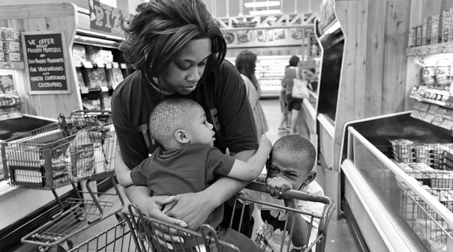

Prince George's County Economic Development Corporation Food Desert Relief Plan
January 18, 2017

Slide 2

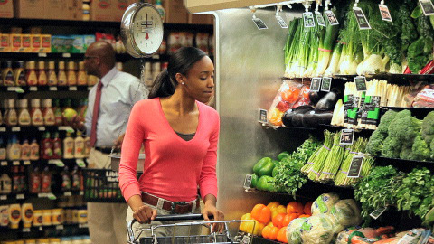
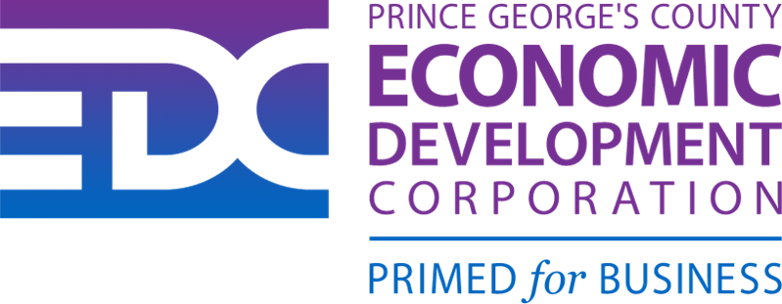
Food Desert Relief Plan Agenda
Primary Causes of Food Deserts
Food Desert Relief Action Plan:
Targeted Locations in Food Deserts to place Emerging Grocers
Develop List of Emerging Grocers
Assess Emerging Grocers for Relief Criteria
Develop “Emerging Grocer Selling Story”
Meet with Principals of Emerging Grocers
Close Deals with Emerging Grocers
Community Based Solutions

Slide 3
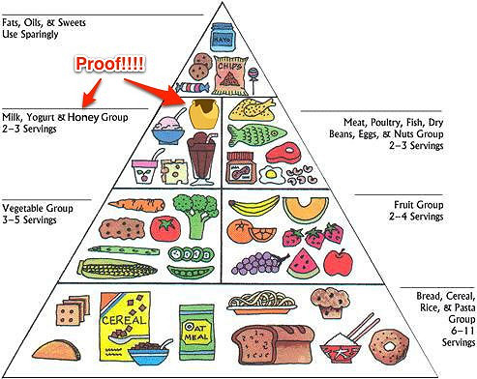
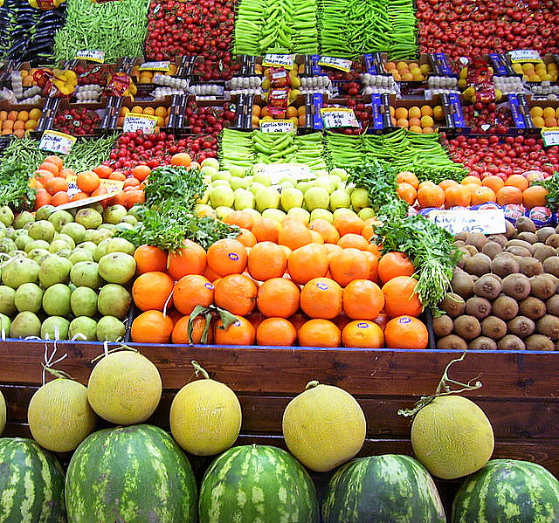
What is a Food Desert?
A food deserts is a geographic area where residents are restricted from access to affordable groceries and healthy food options (especially fresh produce like fruits and vegetables).
Access is restricted or nonexistent due to the absence of grocery stores within a convenient travelling distance..

Slide 4
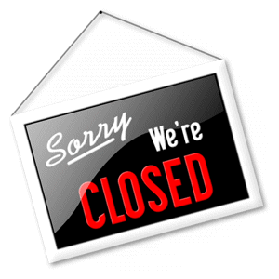
Why Stores Close and Leave
Causes:
High density of low income residents
High operating costs
Profit margin erosion
Increased industry competition
Outdated façades and in store displays
Effects:
Creates food desert
Deprives customers of access to quality groceries and produce
Creates large commercial vacancies
Increases the unemployment rate

Slide 5
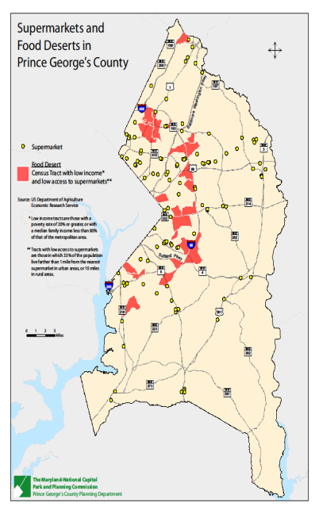
Map of Current Food Deserts in County source: MNCPPC

Slide 6
Targeted Food Desert Locations
Central Avenue
8800-9195 Central Ave - Kingdom Square
5944 Martin Luther King Jr. Highway
Cheverly / Fairmount Heights
7001-7101 Martin Luther King Jr Hwy
Forestville
6333-6491 Marlboro Pike
Morningside/ Camp Springs
4803-4941 Allentown Rd
College Park/Greenbelt
8819-8865 Greenbelt Rd
Glenarden
8000 Martin Luther King Jr Hwy
New Carrollton
8301-8445 Annapolis Rd
Oxon Hill Glassmanor
10 Audrey Ln
Wheeler/ St. Barnabas
4305-4335 St Barnabas Rd
Laurel
14828 Baltimore Ave

Slide 7

Preliminary Grocer Target Lists
State of Maryland
B. Green & Company, Inc.
Fairland Market, Inc.
Klein's ShopRite of Maryland
Santoni's Market Place & Catering
Prince George’s
Lidl
Jumbo Food International Supermarket
Grand Mart International Food
Giant Food
La Grande Supermarket - Riverdale
New Grand Mart - Langley Park
Best Way – Hyattsville Glyndon, MD
Washington, DC
Mom’s
Good Food Markets
Each Peach Market
Capitol Supermarket
Glen's Garden Market
A & S Grocery
Metro Supermarket
Smucker Farms of Lancaster County
Eastern Market
J & F Grocery Store Inc.
Jones Grocery Store
Brookville Supermarket
Yes! Organic Market
Union Market
Morazan Grocery Store
Elmira Grocery Inc.
Geranium Market
Magruder's
Fourth Street Market
Asian & Oriental Food Store

Slide 8
Prince George's County Food Desert Relief Action Plan
Key Strategy / Tactic
Description
Owner
Deadline
Status
Work with Park &
Identify approved zoned spaces
Planning to secure a
inside of the beltway for Grocery
list of approved sites
Larry Hentz
Friday, November 25, 2016
Completed
Stores.
by address where
Grocer's can build a
store.
Established standards
Identify targeted list of Grocers who
for assessment of
would be good candidates to fill
current grocer outlets.
Larry Hentz
Friday, February 03, 2017
In Progress
vacant spaces
Begin assessment of
targeted grocer outlets
and stores.
Develop official proposal and selling
Develop presentation,
story to secure commitments from
incentives, workforce
Larry Hentz, Dr.
targeted grocery chains to invest in
support and fast
Ganguly and Jim
Monday, February 06, 2017
In Progress
the inner beltway market through the
forwarding of
Coleman
construction of new grocery stores.
permitting and
approvals.
Visit local grocery
Larry Hentz, Dr.
Conduct market tour with targeted
outlets, assess viability
Ganguly, Jim
February 15 - April 28,
Planning Stages
grocers to assess available sites.
to participate in our
Coleman, Paul
2017
expansion plans.
Rowe, DBDs
Arrange to meet with
Arrange individual meetings with key
the decision makers of
Larry Hentz, Dr.
principals of targeted grocery store
the stores that meet
Ganguly, Paul
Start March 15 - April 28,
Planning Stages
chains.
our high standards
Rowe, Jim
2017
from the Assessment
Coleman
Tour.
Convince leading grocery chains to
Sell decision makers
Larry Hentz, Dr.
either buy or lease space and to build
on locations and
Ganguly, Paul
June - August 2017
Planning Stages
grocery stores
market opportunity.
Rowe, Jim
Coleman

Slide 9
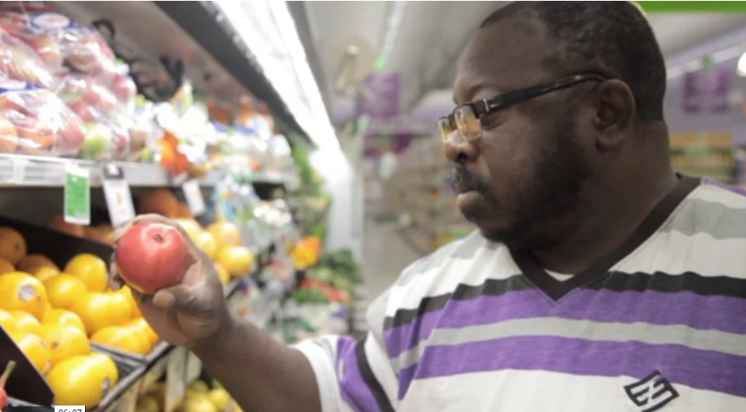
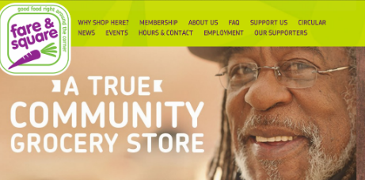
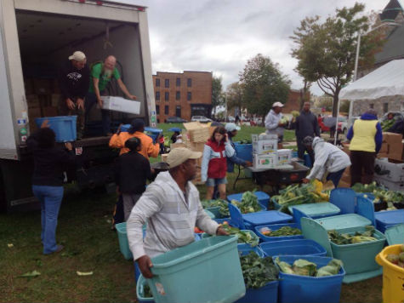
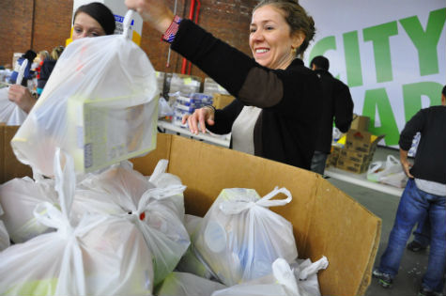
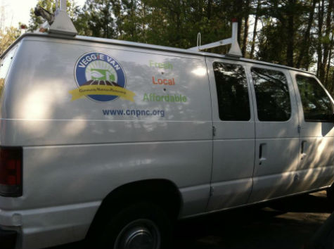
Community Based Food Desert Solutions
“Fare & Square” Chester, PA
“Gather Baltimore” Baltimore, MD
“City Harvest” New York City
“Veggie Vans” New York City

Slide 10
“Fare & Square” – Chester, PA
Chester, Pa., a community of 35,000 once had five supermarkets.
But they started closing as manufacturing jobs disappeared and poverty in the city skyrocketed.
The last supermarket in Chester closed in 2001.
Then, in September, Fare and Square opened for business.
The 16,000 square foot operation offers discounts to people with income below the federal poverty level.
Some 60 percent of Chester's population has signed up for those discounts.
Fare & Square

Slide 11
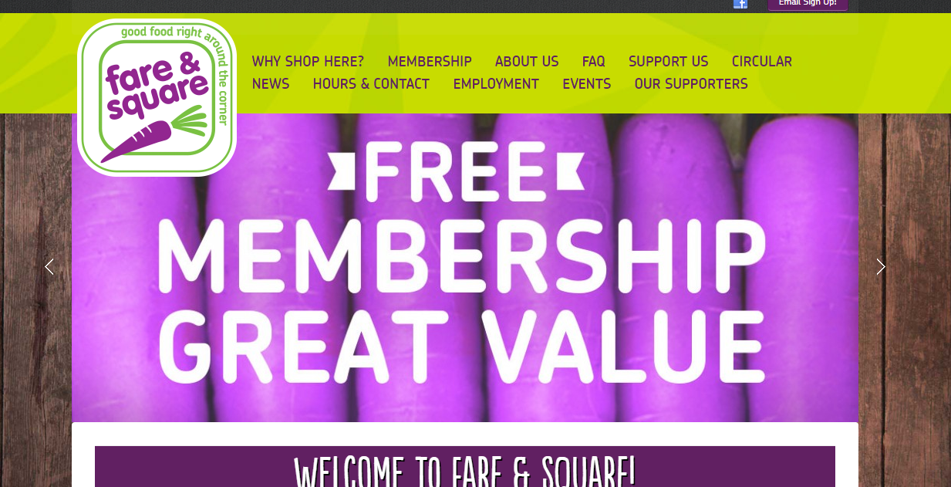
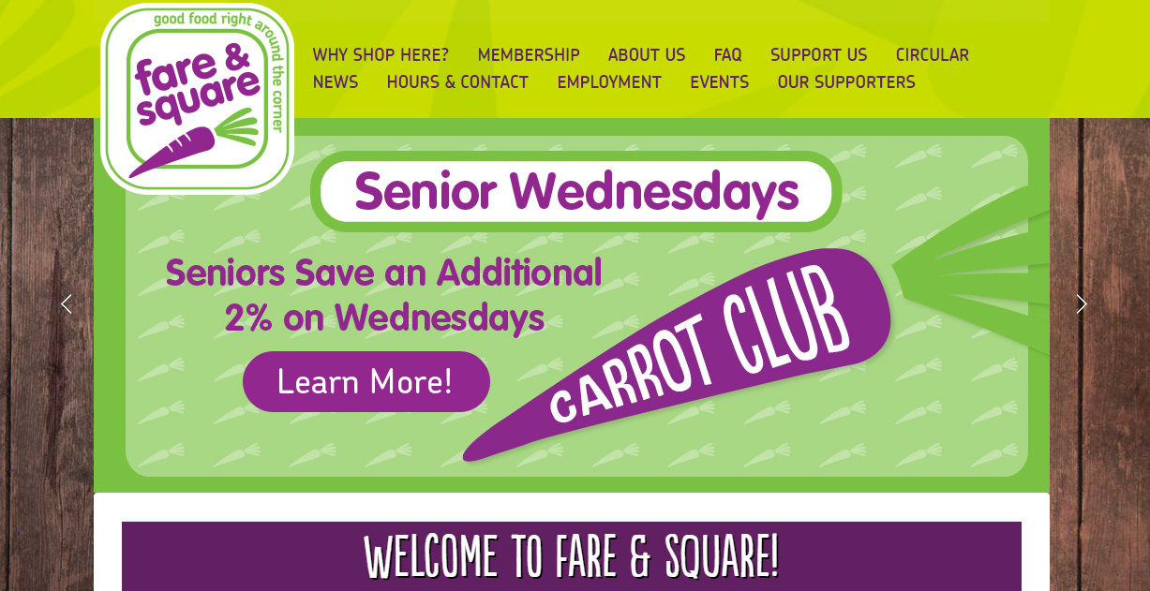
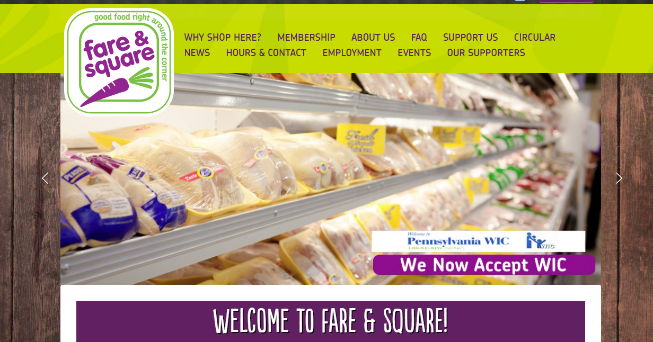
“Fare & Square” – Chester, PA

Slide 12
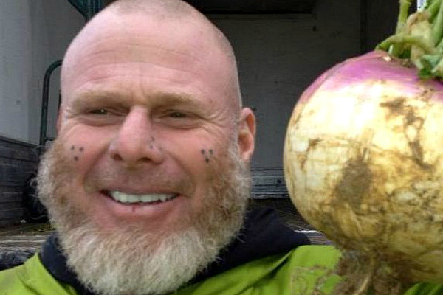
“Gather Baltimore”
The opposite of a food desert is a place where there's so much good, healthy food that much of it winds up wasted.
In other words, the opposite of a food desert is much of the rest of America.
Arthur Morgan is the sort of guy who has linked the two worlds in Baltimore Maryland.
Volunteers collect food that would otherwise be wasted from farmers markets, local farms and produce distributors.
The food is then delivered to families in need in neighborhoods where healthy food is not readily available.

Slide 13
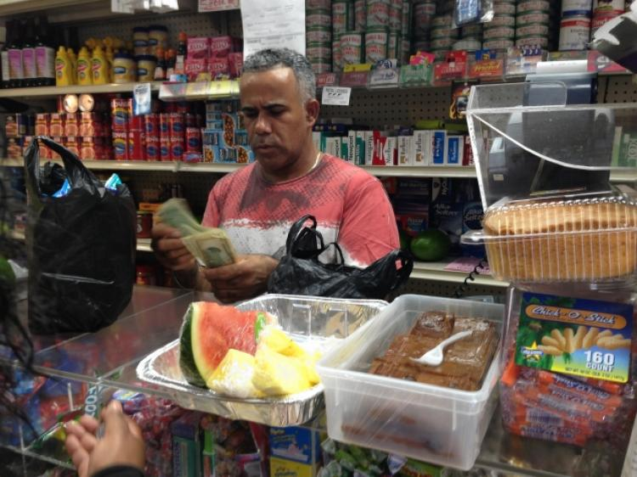
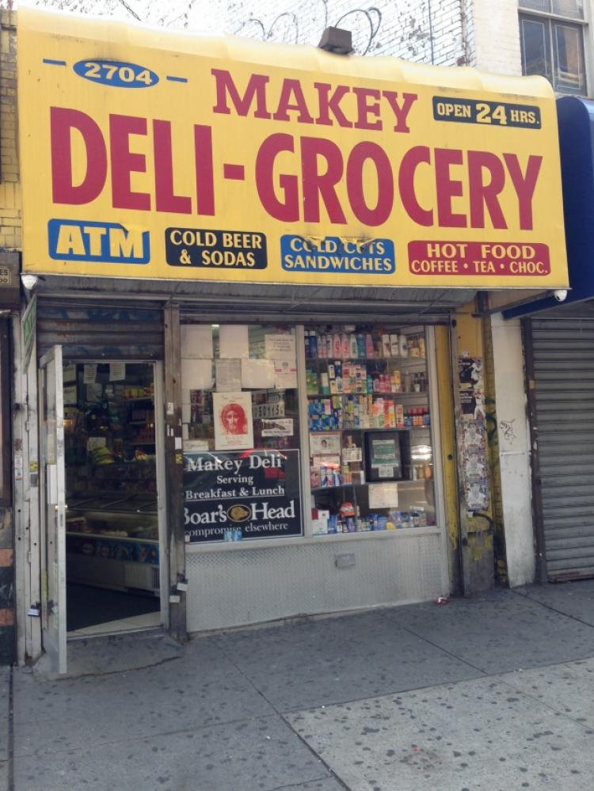
“City Harvest” – South Bronx, NY
Urban food deserts are often filled with places to buy food ... just not healthy food.
And no place is this more true than in the South Bronx, where tiny corner bodegas are the only shopping option for tens of thousands of people.
City Harvest, a non-profit with multiple operations in NY City is teaming with local bodegas and teaching store owners and employees how to buy, store and market fresh produce.
The first stores to participate, the number of produce types carried rose from just three to 24, some of them precut and given prominent display at the front of the store.

Slide 14
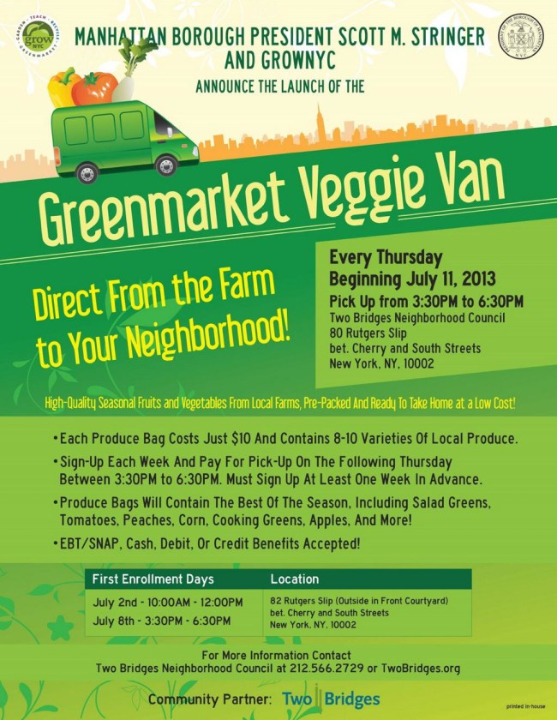
“Veggie Vans” – New York City
When the Pathmark store on Cherry Street in the New York neighborhood closed late in 2012, it left the area with few options.
The community stands in the shadows cast by the Brooklyn and Manhattan bridges is home to a number of public-housing projects and large numbers of elderly people.
So if the people can't get to the food, why not bring the food to the people?
That's the idea behind the Veggie Van, the brainchild of local elected officials and activists.
Vans deliver bags of fresh fruit and veggies, priced at $10 a bag, to residents who sign on as customers.
Some 125 families signed on to the program within the first few days.

Slide 15
“Veggie Vans” – New York City

Slide 16

Federal Financial Resources
U.S. Health Human Services Department:
Awards competitive grants to Community Development Corporations to support projects that finance grocery stores, farmers markets, and other sources of fresh nutritious food.
Projects serve the dual purposes of facilitating access to healthy food options while creating job and business development opportunities in low-income communities.
USDA and the Department of Treasury:
Supports public and private investments in the form of loans, grants, promotion, and other programs designed to create healthy food options in food deserts across the country.
Provides financial and technical assistance to eligible fresh, healthy food retailers for the purposes of market planning and promotion efforts, as well as infrastructure and operational improvements designed to stimulate demand among low-income consumers for healthy foods and to increase the availability and accessibility of locally and regionally produced foods in underserved areas.

Slide 17
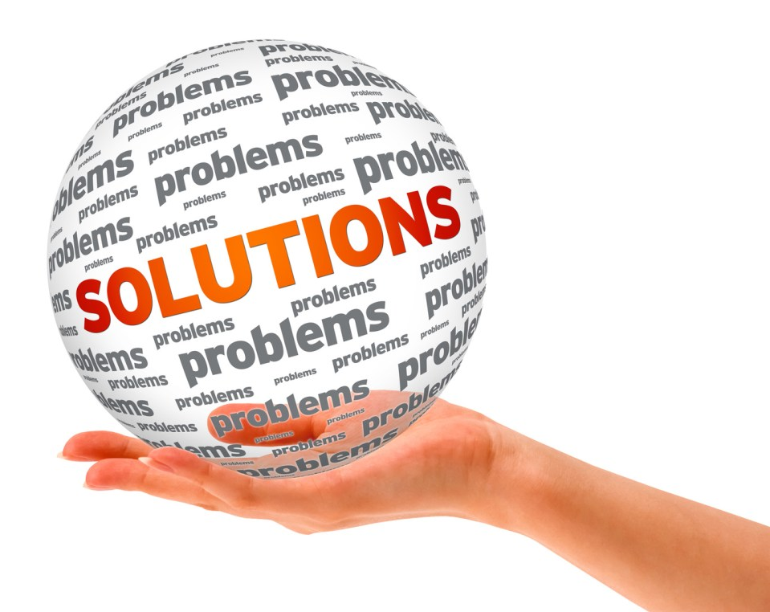

County Based Suggested Solutions
Increase tax credits for grocery stores inside the beltway. Example: Baltimore Grocery Store Tax Credit.
Approve increased housing density in targeted areas.
Allow each grocery store chain with four or more stores in the County to have 3 locations which offer beer and wine.
Accelerate the permitting process to create grocery stores which offer gas.
Offer incentive to small independent stores for offering fresh produce in targeted areas.
Increase partnership with local farmers, farmers markets and vendors.
Create Food Depots from converted older shopping centers.
Locate and attract local independent and International chains from County, greater Maryland, DC, Virginia and Southward to uncover goals and present County opportunities.

Slide 18
Business Development Update

Slide 19
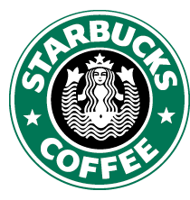
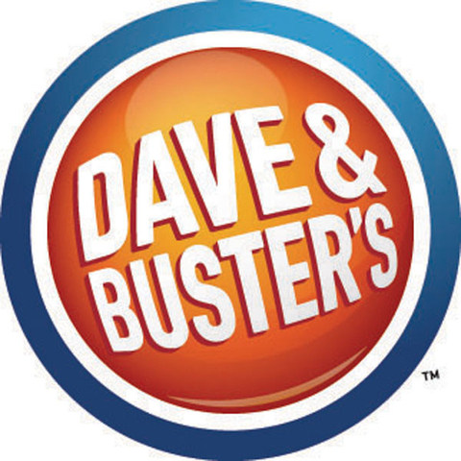

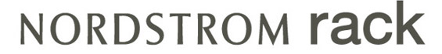
Big New Acquisition Wins 25 new businesses have decided to relocate and / or expand in Prince George’s County from July 1, 2016 – December 31, 2016!
Petrie – Richardson
Cava Mezze Grill
Andrews FCU
Starbucks
Stantec
Denison Landscaping
Sheehy Leasing
Highway and Safety Services, Inc.
Sigma Space / Optoro Traffic
Allied Deccan Services
NextCure, Inc.
Dave and Buster’s *
Nordstrom Rack *
Southland Industries
A. Wash & Associates
Book Store Movers
Floranation
Divine Unity Foods
International Crowned Grace
J & K Imports
Olive Garden
Crane Rental Company

Slide 20


What Does This Mean For Prince George’s County?
Total Capital Expenditures: $67 Million
Total Projected Jobs: 1229
Estimated Tax Revenue: $2.7 Million

Slide 21
2016 EDI Fund Transactions

Slide 22
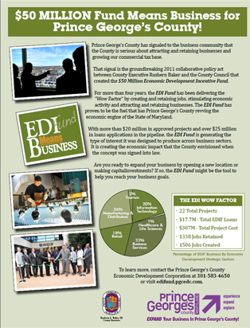
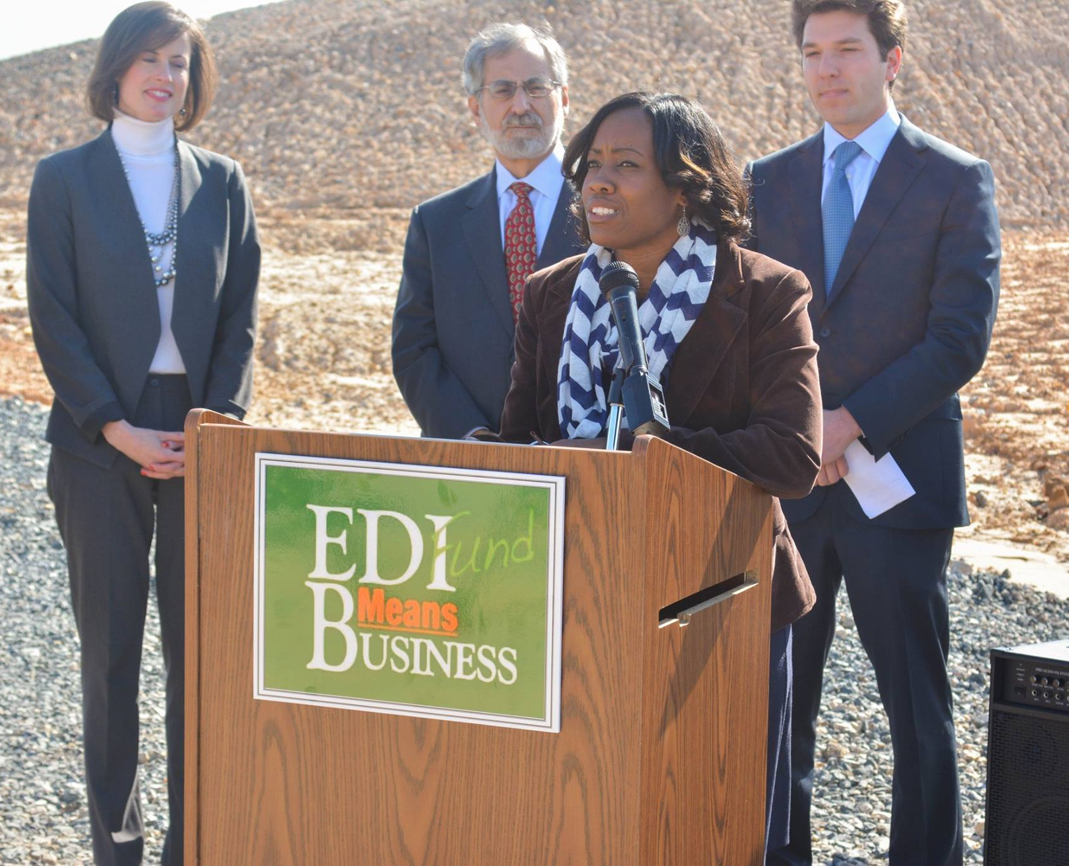
YTD Economic Development Incentive Fund Performance

Slide 23
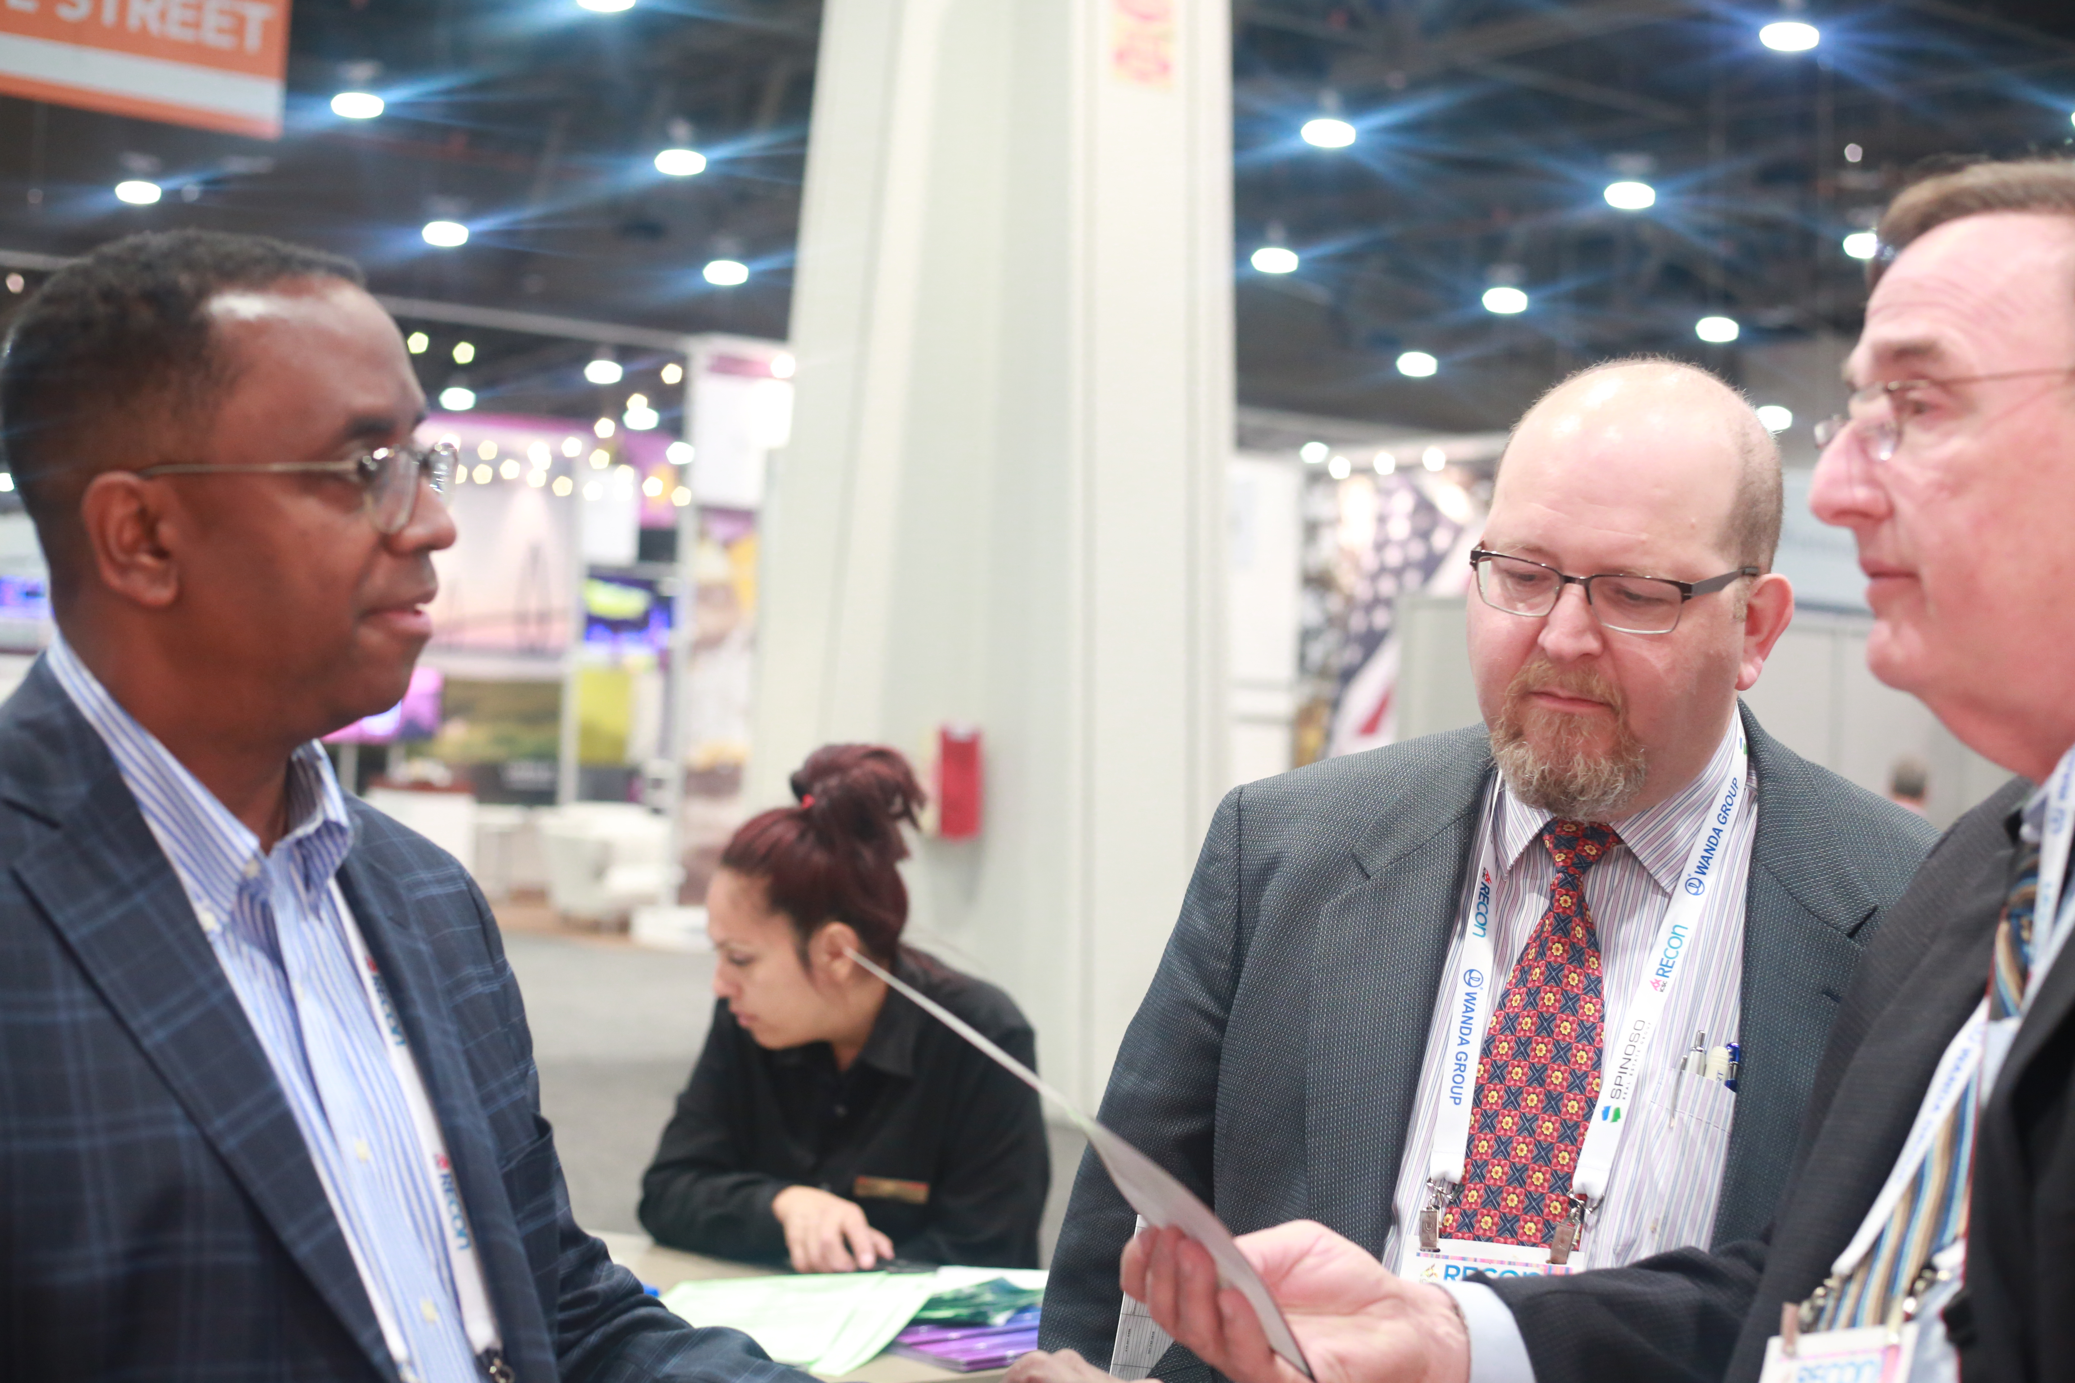
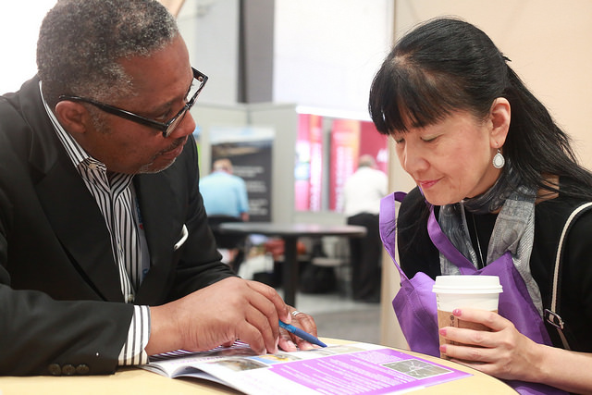
ICSC 2016 Wins and Highlights
507 Visits to the Prince George’s County / EDC
57 Walk-up meetings at booth
19 Pre-scheduled appointments at the booth
Nordstrom Rack Department Store
1st in County: Woodmore Towne Centre
30,000 SF
60 full time jobs
CapEx $8 million
Krispy Kreme Doughnut Shop
1st location in County: Capital Heights
30,000 SF
Negotiating 5 additional locations in County
20 full time jobs / location
$2.6 million CapEX / $2 million, revenue / location
Beltsville Land LLC
Sorting and storing facility, direct to consumer retail store, and an operations office
$1.8 million CapEx and 30 full-time jobs

Slide 24
This is no time for cooling off!!
EDC Opportunity Pipeline as of January 18, 2017
Director of
Total
Total Cap-X
New Full Time
Business
Projects
Value
Jobs
Development
David Lewis
11
$44,100,000
713
Mayank Kapur
11
$88,410,000
1,300
Larry Hentz
9
$403,850,000
2,820
John Mason
24
$445,425,000
3,012
Total EDC Pipeline
55
$981,785,000
7845

Slide 25
David Lewis, DBD

Slide 26
Mayank Kapur, DBD

Slide 27
Larry Hentz, DBD

Slide 28
John Mason, DBD

Slide 29
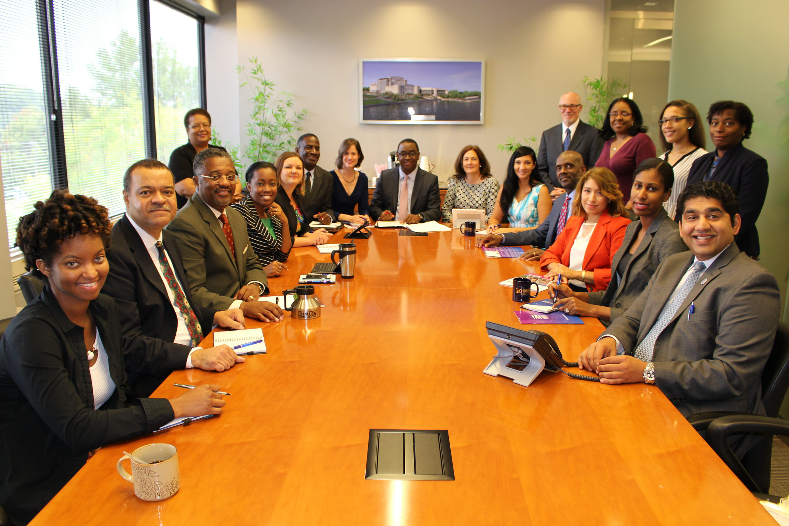
Activating Prosperity!
The Prince George’s County
Economic Development Corporation
1801 McCormick Drive, Suite 350
Largo, MD 20774
Contact us today:
301-583-4650
www.pgcedc.com
info@pgcedc.com

