Slide 1
2025 Legislative Year End Data

Slide 2
3 2025 Legislative Data
4 Education and Workforce Development Committee
5 General Assembly Committee
6 Government Operations and Fiscal Policy Committee
7 Health, Human Services and Public Safety Committee
8 Planning, Housing and Economic Development Committee
9 Transportation, Infrastructure, Energy and Environment Committee
Table of Contents

Slide 3





Number of Bills
Number of Resolutions
Total Combined
# of zoning bills
Total Number of bills passed
Total Number of bills failed
Total number of bills held in committee
Total number of bills/resolutions submitted by CEX
Committee with highest number of bills (excluding COW)
105
45
250
14
198
5
15
91
GOFP

Slide 4
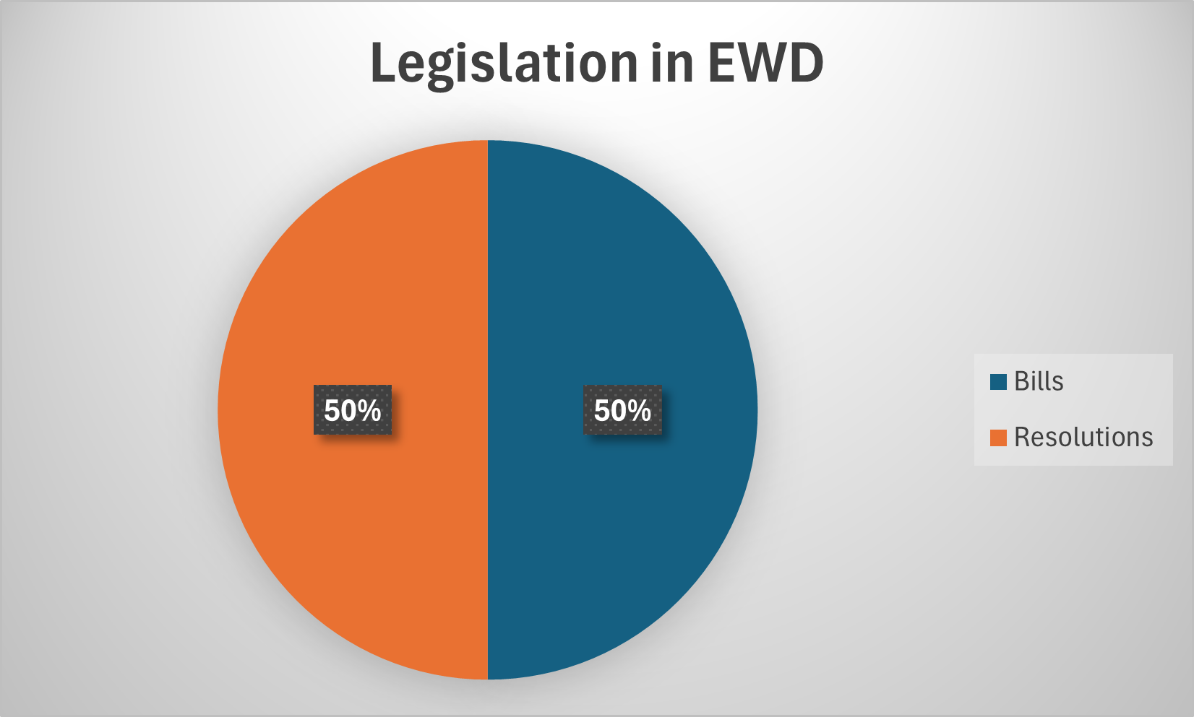
Education and Workforce Development Committee
3 Notable Pieces of Legislation
CR-088-2025: Improving Prince George's County Literacy
CB-087-2025: National Board-Certified Teacher Incentive Program Match
Seeks to establish a literacy commission to improve literacy rates across Prince George's County.
Calls on the Prince George's County Board of Education to initiate an audit to ensure compliance with State and Local mandated over-dose reversing medication in schools.
Seeks funding for National Board-Certified Teachers who teach in Math, Science, and Special Education in low-performing schools.
CR-076-2025: The Readiness of Prince George's County Public Schools in a Potential Overdose Emergency

Slide 5
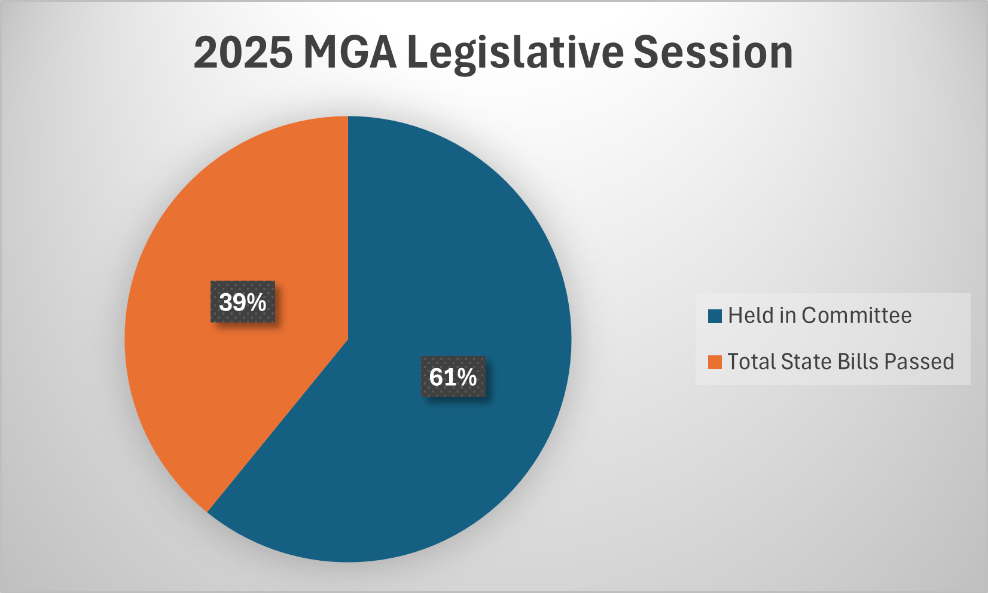
General Assembly Committee
PG 306-25 (HB349) | Increases the civil penalties for violations recorded by speed monitoring systems along MD Route 210.
PG 403-25 (HB 372) | Repealed the termination of the Prince George's Gateway authority.
MC/PG 113-25 (HB 1470) | Mandates DPIE must record a lien on a property that is the subject of a violation to levy enforcement actions. Requires the County to vacate certain enforcement actions.

Slide 6
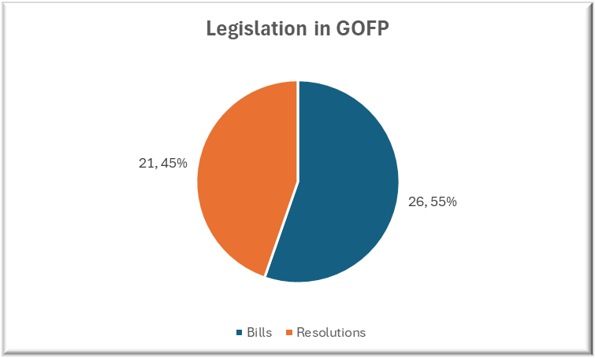
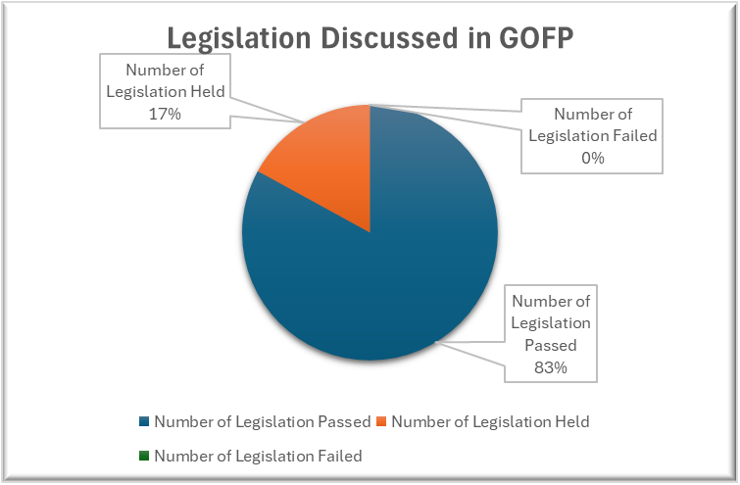
Government Operations and Fiscal Policy Committee
3 Notable Pieces of Legislation
CB-005-2025: Minimum Wage Indexing
CB-009-2025: THE REVISED ELDERLY PROPERTY TAX CREDIT
CB-016-2025: Public Safety Employment Decisions
The legislation would index the Prince George’s County minimum wage to the Consumer Price Index and address the adverse impact felt by Direct Support Professionals by helping keep pace with minimum wage increases.
Modifies the current elderly property tax credit to make its applicability exclusive of and separate and distinct from the Homestead and Maryland Homeowner’s Property Tax Credit. It changes the yearly thresholds for eligibility, as well as addressing any resulting hardships.
Modifies existing legislation to protect applicants for uniformed positions with the County Police and Fire/EMS departments. Applicants would not be denied certification or selection exclusively based on a positive pre-employment screening for cannabis or marijuana.

Slide 7
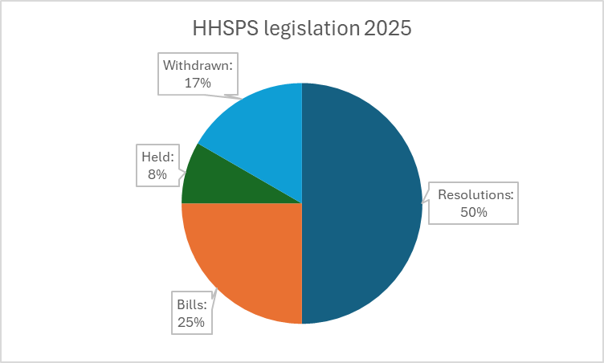
Health, Human Services and Public Safety Committee
3 Notable Pieces of Legislation
CB-067-2025: THE PRINCE GEORGE’S COUNTY FOOD AS MEDICINE HEALTH PROGRAM ACT OF 2025 | Creates a new "food as medicine" Health program and workgroup to implement the program
CR-092-2025: FEASIBILITY STUDY FOR A COUNTY-OWNED GROCERY STORE PILOT PROGRAM | Authorizes a feasibility study for a County-owned grocery store
CR-054-2025: HEALTH ATLAS & PUBLIC HEALTH IMPACTS | Authorizes M-NCPPC & the Health Dept to develop a Health Atlas. The Health Dept will also conduct a study on the public health impact of fast-food restaurants, liquor stores, and tobacco stores.

Slide 8
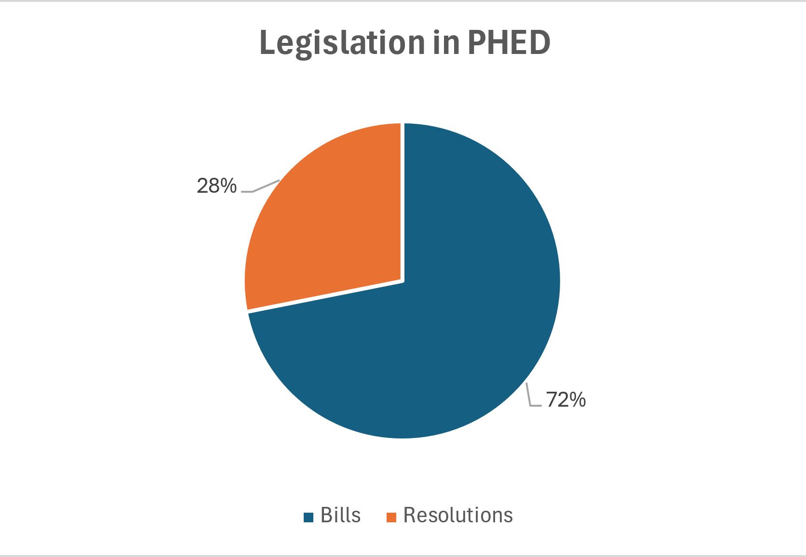
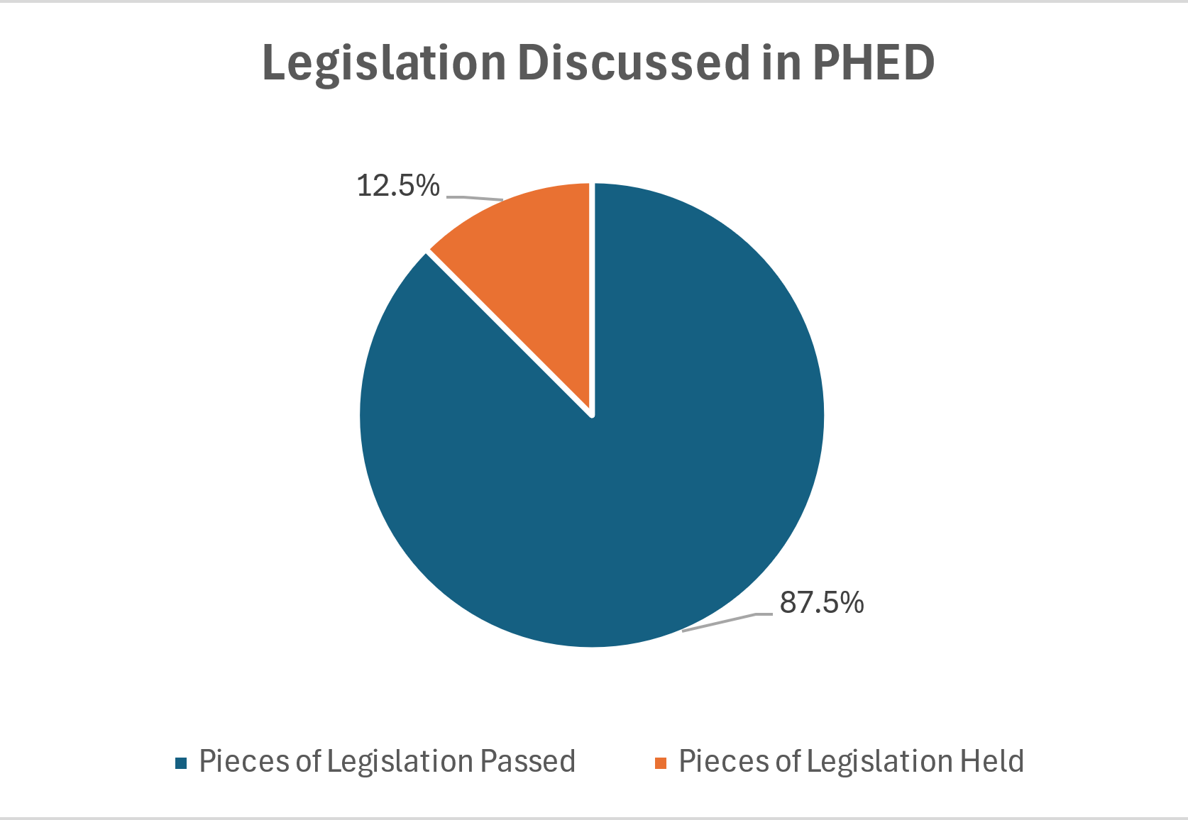
Planning, Housing and Economic Development Committee
3 Notable Pieces of Legislation
Enables relocation payment for certain housing unfit for habitation. This Bill was widely supported by residents, as it would assist them in challenges where relocation was needed due to issues caused by the Landlord. This would reduce future social service costs for the County.
Seeks to develop an MDPU program for home buyers in all areas of the County, which in turn will reduce future home buying costs and potentially increase the County’s tax base.
Limits the location of new fast-food restaurants with drive-throughs by prohibiting such uses in residential zones and allowing such uses by special exception in certain commercial zones to address the unique impacts associated with quick-service drive-through restaurants.

Slide 9
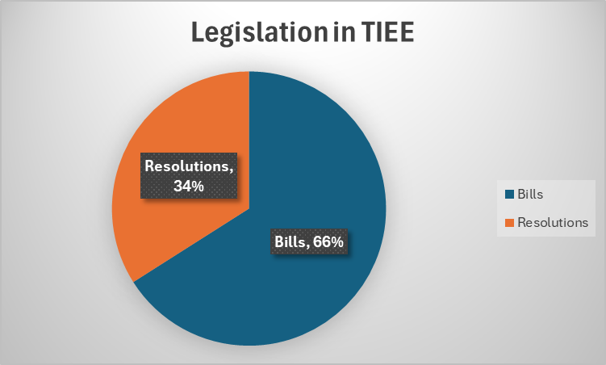
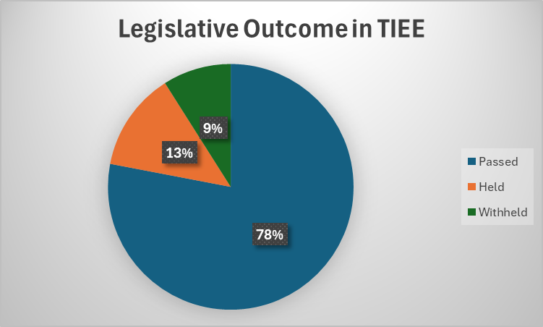
Transportation, Infrastructure, Energy and Environment Committee
3 Notable Pieces of Legislation
CB-012-2025: Snow Removal Operations Reporting
CB-023-2025: Wildlife and Animal Control
This legislation was initiated by a relatively severe snow and ice storm that left many residents stranded at their homes. The Bill requires the Dept. Of Public Works & Transportation to provide Council with situational reports for pre-treatment, communications, and updated status of road conditions.
The legislation provides a fee for displacement of wildlife due to development. DoE issued a report with robust fiscal impacts estimated at $875K per annum plus $665K for equipment and training (first year), and additional costs if waterway inspections were included.
Increases fines for Animal Services Division (ASD) violations, amends definitions such as "Dangerous Animal" and "Potentially Dangerous Animal". It also allows ASD to waive Dangerous Animal prohibitions under certain conditions, provides flexibility for "At Large" animal provisions, limits leash lengths, and creates a pilot program for fostering and adoption of pit bull terriers and similar canines.
CB-097-2025: Animal Control

