Slide 1
Accessory dwelling units task force
November 5, 2025

Slide 2
Agenda
Defining ADUs
Types of ADUs
Prince George’s County Zoning Ordinance
Benefits of ADUs
Neighboring Jurisdictions
State Law Requirements

Slide 3
Defining accessory dwelling units
Smaller, independent residential dwelling unit located on the same lot as a stand-alone single-family home. They can be separate or attached to the single-family home, but must not exceed 75% of the single-family home's size.
Also known as:
Accessory apartments
Secondary suites
Granny flats
American Planning Association

Slide 4
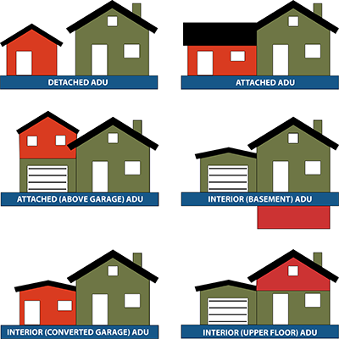
Types of accessory dwelling units
Detached ADU – New stand-alone accessory structures or converted portions of existing stand-along accessory structures. (Detached garage, new cottage)
Attached ADU – Additions to new or existing homes. (Attic, basement, addition)
Internal ADU – Converted portions of existing homes.
American Planning Association

Slide 5
Prince George’s County Zoning ordinance definition Of Accessory structure
A structure subordinate and incidental to, and located on the same lot with, a principal structure and use, the use of which is customarily found in association with and is clearly incidental to the use of the principal structure or the land, and which is not attached by any part of a common wall or roof to the principal structure. (When a specific structure is identified in this Ordinance as accessory to another use or structure, the structure need not be customarily incidental to, or ordinarily found in association with, the principal use to qualify as an accessory structure).
Subtitle 27: Zoning Ordinance > PART 27-2 INTERPRETATION AND DEFINITIONS > Sec. 27-2500 Definitions > Accessory structure

Slide 6
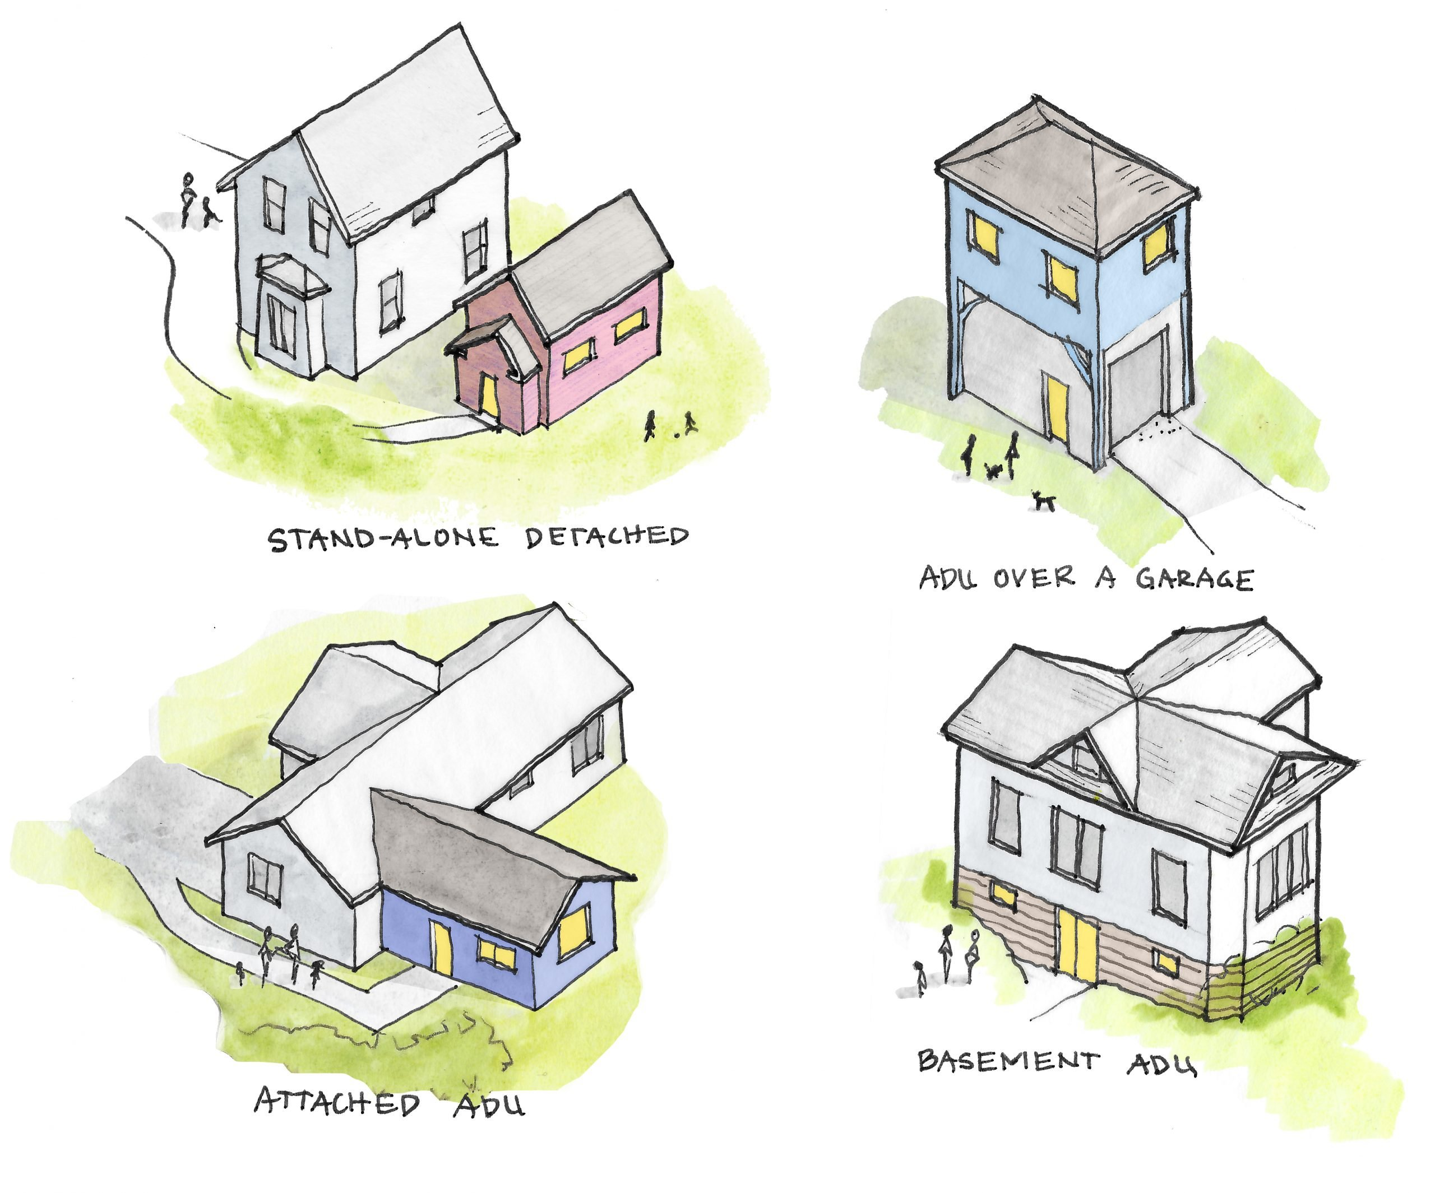
Benefits of accessory dwelling units
Increase housing affordability for homeowners and tenants.
Increase range of housing options and address housing shortages.
Promote aging in place for seniors.
Encourage use of existing housing fabric in established neighborhoods.
ADUs require fewer resources to build and maintain than full-sized homes and potentially use less energy for heating and cooling.
Potentially increase property value.
American Planning Association

Slide 7
Neighboring jurisdictions: Montgomery county
Effective since July 2019, ZTA 19-01
  Allowed in smaller residential zones on the same lot as an owner-occupied single-family home.
  Smaller than the main house and a stand-alone structure in the backyard, a basement apartment, an addition, or an apartment over the garage.
  The zoning code allows in certain residential zones: Separate entrance located:
    On the side or rear of a dwelling, front of the dwelling; or
    At the front of the principal dwelling, if the entrance existed before May 20, 2013; or
    At the front of the principal dwelling, if it is a single entrance door for use of the principal dwelling and the Attached Accessory Dwelling Unit
  The maximum gross floor area for a Detached Accessory Dwelling Unit must be the least of:
    50% of the footprint of the principal dwelling
    ii. 10% of the lot area; or
    1,200 square feet of gross floor area
Anne Arundel County ADU Zoning Requirements

Slide 8
Neighboring jurisdictions: ANNE ARUNDEL County
Effective May 2023, Bill 6-23
Allowed in any Residential Zoning District except in the R22-Residential District and on land designated RCA-Resource Conservation Area in the Chesapeake Bay Critical Area.
No minimum lot size.
Maximum of one ADU per lot.
The Zoning Code allows for separate entrances:
  Use the same street address as the single family detached dwelling and be designated as Unit “B”.
Can be located within, attached to, or detached from a single-family dwelling.
The maximum gross floor area of a Detached Accessory Dwelling Unit must be the least of:
  800 square feet or 50% of the floor area of the single family detached dwelling.
An ADU is exempt from impact fees provided the ADU is not constructed during the construction of the single family detached dwelling.
An ADU or the single family detached dwelling may be used as a Short-Term Rental if either dwelling is owner occupied.
Montgomery County ADU Zoning Requirements

Slide 9
State law requirements
HB 1466 established a State policy to encourage the creation of ADUs on land with a single-family detached dwelling unit, to meet housing needs. It requires:
Adoption of specified local laws authorizing ADUs on or before October 1, 2026
Prohibits a restriction on use of a property from unreasonably limiting the ability of an owner to develop or offer an ADU
Authorizes homeowner associations (HOAs) to treat an ADU as a separate lot for purposes of voting and assessments
The accessory dwelling may or may not be used as a short-term rental

Slide 10
Thank you

