Slide 1

Volunteer Fire Commission
FY 2026 Budget Overview
Budget & Policy Analysis Division
Malcolm Moody, Policy Analyst
May 1, 2025

Slide 2
Agenda
Department Overview
Strategic Focus
General Funds
Grant Funds
Staffing
Equipment & IT
Staff Comments

Slide 3
Fire/EMS Department
Mission
Strives to improve the quality of life in Prince George’s County by promoting safety and providing the highest quality of fire prevention, fire protection, emergency medical services and community outreach programs.
Fire Chief (Tiffany D. Green)
Emergency Services Command
Support Services Command
Administrative Services Command
Volunteer Services Command
Fire Commission
Core Services
Emergency medical services including basic and advanced life support
Fire Suppression
Rescue services, including technical rescue, confined space rescue, high angle rescue, marine rescue and swift water rescue
Hazardous materials, bomb and explosive device response
Fire and arson investigations
Fire prevention and life safety, including fire inspections, enforcement and public education
Notes:
Speaker Notes
- Left: Organization structure, Top: Main Mission which is in the budget book, Right: Core Services provided which is in the budget book
- Source: Budget Book pg. 347 for Mission, Core Services, and Org makeup
This slide covers the Mission, Structure, and Core Services of the Volunteer Fire. All of this can be found in the Budget Book on pg. 347
On the next slide…

Slide 4
Strategic Focus FY 2026
Improve service delivery and reliability throughout the County utilizing real-time performance analytics and system wide situational awareness to meet performance standards
Replace outdated Self-Contained Breathing Equipment for entire agency
Increase sworn staffing total to meet minimum staffing requirements
Create a facility maintenance strategic plan for 45 aging fire stations
Achieve “Candidate Agency” status for accreditation with the Commission of Fire Accreditation International (CFAI) through the Center for Public Safety Excellence (CPSE)
Notes:
Speaker Notes
Budget Book pg. 348
This covers the strategic focus of the Volunteer Fire, which is found on pg. 348 of the Budget Book
Next is

Slide 5
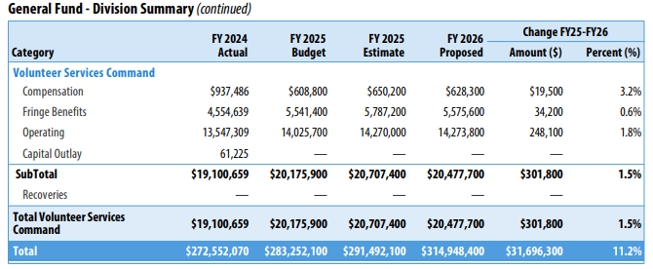
General funds
Proposed FY 2026
$20.5 Million
Increase $301,800 million or 1.5%
+$628,300 COMPENSATION
Annualization of FY 2025 and FY 2026 salary adjustments
+$14.3 Million OPERATING
+$5.6 Million Fringe Benefits
Increase due to insurance premiums, contracts, other operating equipment, gas and oil, equipment lease and equipment repairs.
Increase to align with projected costs
Increase in fringe benefit rate from 72.0% to 75.7%
Notes:
Speaker Notes:
Source: FY 2026 Budget Book pg. 353/358
This slide focuses on the General Funds, which is proposed at $20.5 million in FY 2026 an increase of $301,800
Charts show that all expenditure categories saw an increase. Explanations for what each category funds is listed as well.
All of this can be found on pg. 353 and 358 of the budget book.

Slide 6
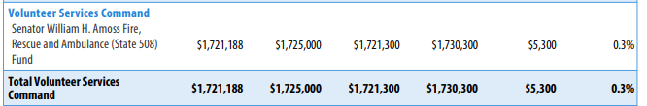
GRANT FUNDS
Proposed FY 2026
$1.7 Million
Increase $5,300 or 0.3%
Sourced entirely from Amoss, Rescue and Ambulance Fund
Notes:
Speaker Notes:
Source: FY 2026 Budget Book pg. 361/364
This slide focuses on the Grant Funds, which is proposed at $1.7 million in FY 2026 an increase of $5,400 from FY 2025
All grant funds from the Amoss Fund
All of this can be found on pg. 361 and 364 of the budget book.

Slide 7
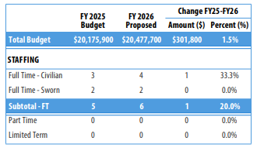
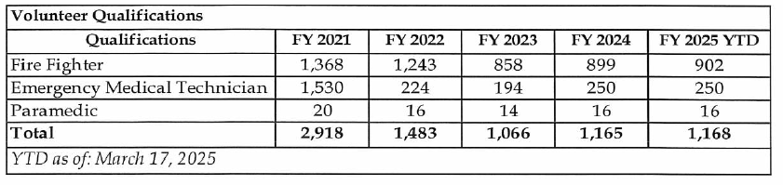

STAFFING
FULL TIME CIVILIAN
FULL TIME SWORN
4 (+1 Position )
2 - Unchanged
6 Staff
TOTAL
Qualifications
As of March 17, 2025, there are 1,168 certified volunteers
Notes:
Speaker Notes
Source: FY 26 1st Rd Response, Q. 15, pg. 13 for the Qualifications Chart
BB pg. 358 for Staff Chart
This slide covers staffing and shows the changes in positions for the agency
On the left you see only ft sworn civilian positions has changed, which has increased by 1 position.
A qualifications chart is on the right side and shows a breakdown of the certified volunteers as of March 17, 2025 is provided.
The info on staffing can be found on pg. 358 of the budget book.

Slide 8


EQUIPMENT & IT
LOSAP Database
Fleet and Apparatus Maintenance
Experienced setbacks due to staffing shortages within the Fire Commission’s Office.
165 out of 254 pieces of volunteer-owned equipment exceed the replacement age
Has hired a dedicated Administrator and streamlined oversight and process in response.
Notes:
LOSAP Database: FY 26 1st Rd pg. 19, Q. 22
Fleet Stuff: FY 26 1st Rd pg. 18, Q. 21

Slide 9
Staff Comments
Infrastructure needs
Equipment Modernization and Replacement
Recruitment & Retention
Repairs needed to Glenn Dale (818), Clinton (825), Landover Hills (830), and Oxon Hill (842)
Efforts to replace aging equipment underway but limited due to reliance on state grants like Senator Amoss funding.
Issues of recruitment and retention of volunteer members
Have enhanced outreach efforts
Progress slow due to funding gaps
Volunteer Training and Certification
Training programs exist but limited in scope due to funding issues
Working to expand opportunities through local university partnerships and online platforms
Notes:
Chart is on staff comments.
Wanted to note that recruitment and retention of volunteer members is an issue
There are also issues with repair to stations and modernizing equipment which are impacted by a lack of funding
Volunteer training programs are also limited due to funding issues.

Slide 10
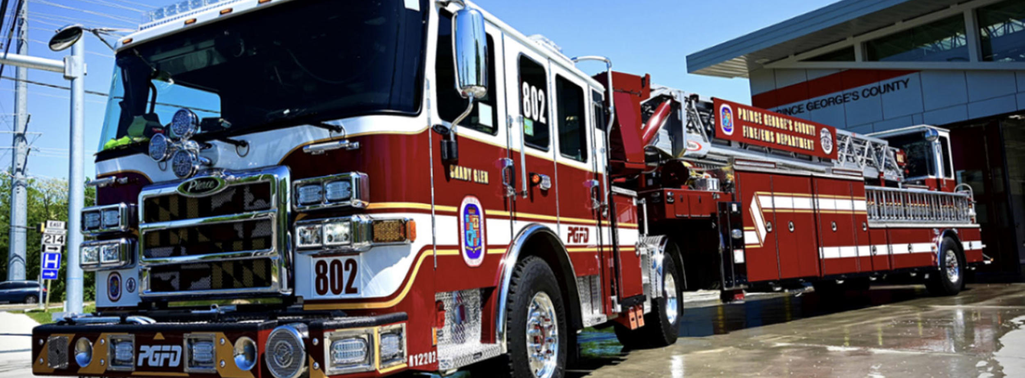



THANK
YOU
Malcolm Moody
+1 (301) 952-5431
mmoody@co.pg.md.us
Notes:
This concludes my presentation to the Committee. Thank you.

