Slide 1

Police Accountability Board
FY 2026 Budget Overview
Budget & Policy Analysis Division
Malcolm Moody, Policy Analyst
May 1, 2025

Slide 2
Agenda
Department Overview
Strategic Focus
Grant Funds & Staffing
Agency Budget Summary & General Fund
State Legislation Status Update

Slide 3
Police Accountability Board
Mission
Works in partnership with law enforcement agencies to develop strategies and recommendations to improve matters of policing, including, but not limited to, imposing effective discipline for proven police misconduct, implementing independent oversight of police policies and practices and increasing police accountability
Kelvin Davall, Chair
Police Accountability Board
Legal Counsel
Staff
Core Services
Hold and attend quarterly meetings with law enforcement agency leadership and work in conjunction with law enforcement agencies and local government to improve police services
Review the disciplinary outcomes of matters submitted to the Board by the Administrative Charging Committee and Administrative Hearing Boards
Submit an Annual report to the County Executive and County Council that analyzes the outcomes of all disciplinary matters, identifies any trends from the disciplinary processes of the law enforcement agencies and makes recommendations for increased police accountability and improved policing
Notes:
Speaker Notes
Source: Budget Book pg. 233
This slide covers the Mission, Structure, and Core Services of the PAB. All of this can be found in the Budget Book on pg. 233
On the next slide…

Slide 4
Strategic Focus FY 2026
Conduct a thorough analysis of complaint trends to identify recurring patterns and systemic issues
Build a diverse portfolio of communication across channels including web-based, in-person events, press releases, toolkits, social media, and printed material to facilitate transparent, trusted, and credible relationships with the community and law enforcement agencies
Develop actionable, evidence-based recommendations aimed at fostering transparency, improving accountability and strengthening community trust in law enforcement
Launch a public awareness initiative to educate residents about the PAB’s role, complaint process and how to access resources
Notes:
Speaker Notes
Budget Book pg. 234
This covers the strategic focus of the PAB, which is found on pg. 234 of the Budget Book
Next is

Slide 5
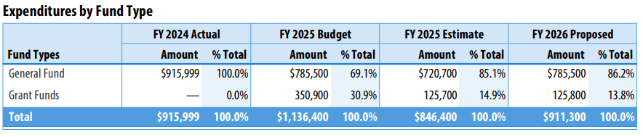
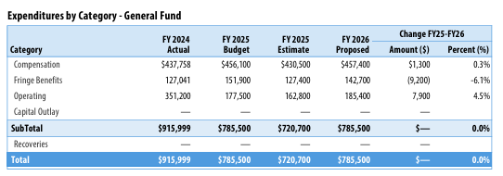
FY 2026 Budget Summary & General FUND
Proposed FY 2026
$911,300
Decrease -$225,100 or 19.8%
+$457,400 COMPENSATION
Mandated salary adjustments
Fund five (5) FT position
$1,300 Increase in compensation
Proposed FY 2026
$785,500
Unchanged from FY 2025 Approved Budget
Due to projected costs for telephone, printing, contract services, county car rental services and general office supplies
$142,700 Fringe Benefits
Decrease by $9,200
Decrease in Fringe Benefit rate from 34.0% to 31.2%
+$185,400 OPERATING
Notes:
Speaker Notes:
Source: Budget Book pg. 234
A slide focusing on the budget summary & general funds. In the top right you will see a chart displaying the expenditures by Fund Type from FY 2024 – FY 2026 Proposed
To the left of that is the total proposed budget for FY 2026, which is at $911,300 and decreased by $225,100 compared to the FY 2025 Budget
Below that is a slide on General Funds for the PAB. Here you see the expenditures in the General Fund for the PAB.
For FY 2026 the proposed amount is at $785,500, which is unchanged from FY 2025
The other charts to the right showcase the different categories in the general fund. Only Fringe Benefits expenses saw a decrease.
Can find this on pg. 234 of the Budget Book
Next…
Next..

Slide 6
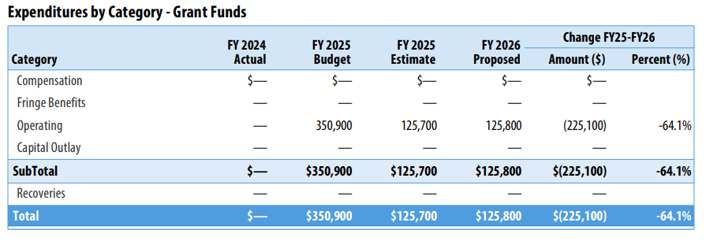

GRANT FUNDS & Staffing
Grant Funding FY 2026
$125,800 a decrease of -$225,100 or -64.1%
Due to reductions in existing Community Awareness Campaign Grant, Community and Transparency Grant
+$125,800 Operating
Used to support program operational expenses
The primary source of funds for the PAB is the Governor's Office of Crime Prevention and Policy (GOCPP)
FULL TIME CIVILIAN
Unchanged
5 Positions
Notes:
Speaker Notes:
Source: FY 2026 Budget Book pg. 238
The chart on the top is from the ACC grant funds(Slide shown on screen).
Correct version will be uploaded to website. The report has the correct amount for Grant funds + reason for decrease
This slide covers grant funds and staffing. On the left side there is a chart showing the reduction in grant funding for FY 2026 along with the reasoning
On the right side is a chart on the operating budget and staffing for the PAB which remains unchanged at 5 positions
Can find this info on pg. 248 of the Budget Book

Slide 7
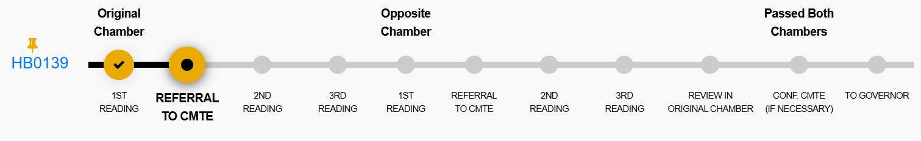
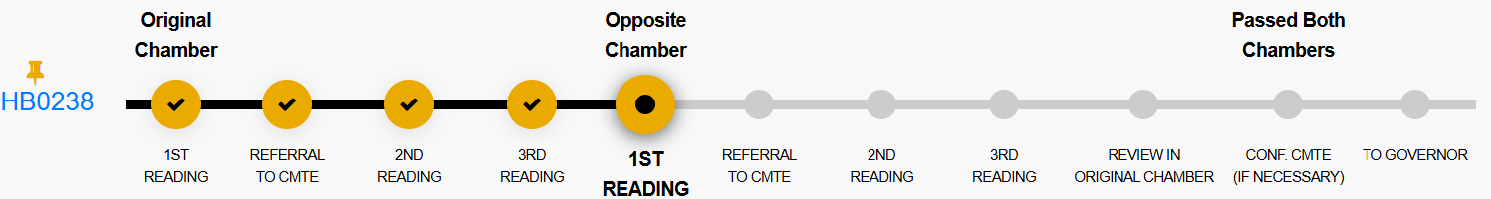
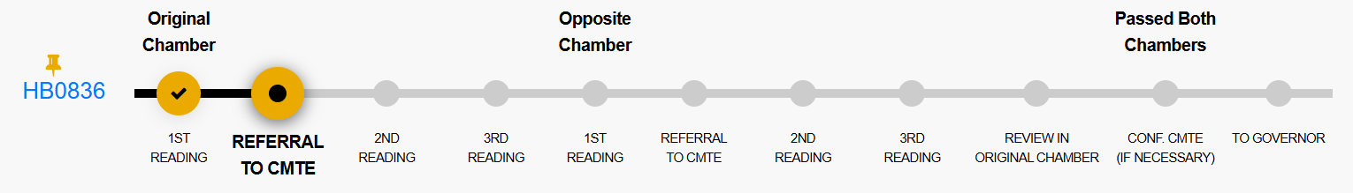
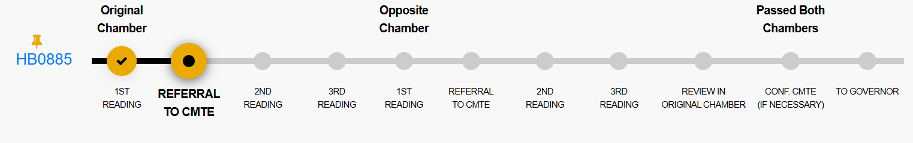
State Legislation Status Update
HB0139 – Police Accountability - Deadline for Completion of Investigation
HB0238 – Police Accountability - Time Limit for Filing Administrative Charges
SB0533 – Police Accountability – Time Limit for Filing Administrative Charges has been sent to the Governor. Was cross-filed with HB0238
HB0836 – County Police Accountability Boards - Investigation of Complaints of Police Misconduct
HB0885 – Police Accountability - Investigation Records Relating to Unfounded and Exonerated Complaints
Notes:
Speaker Notes
- Last slide covers the status on each Bill from the General Assembly site (As of 4/29/2025)

Slide 8




THANK
YOU
Malcolm Moody
+1 (301) 952-5431
mmoody@co.pg.md.us
Notes:
This concludes my presentation to the Committee. Thank you.

