Slide 1


Prince George’s County
Office of Finance
Presentation on Property Taxes
April 9, 2025
Presenters
Larissa Broady
Linda V. Allen

Slide 2

Prince George’s County
Office of Finance
Property Taxes

Slide 3
Prince George’s County
Office of Finance
How are property taxes determined?
Property taxes are based on the assessed value of each property and are calculated using the tax rates and charges that are approved and adopted prior to the beginning of each fiscal year by the County’s annual budget ordinance and various agencies and municipalities.
To calculate your bill: Divide the assessment by 100 and multiply that number by each tax rate listed on the tax bill. Then add any charges for the Clean Water Act fee, Bay Restoration, trash & garbage, recycling, bulky trash or any other fees that may be added if you live in a municipality.

Slide 4
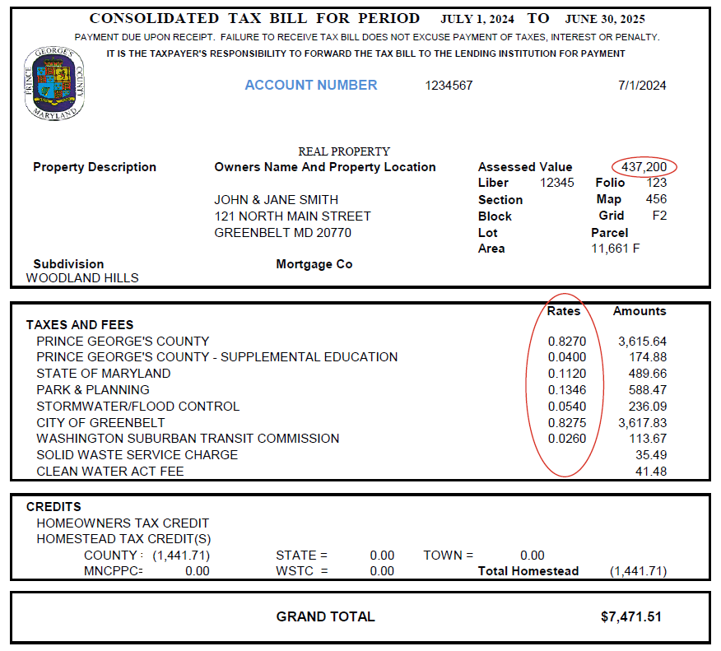
Prince George’s County
Office of Finance
(Sample tax bill pictured below)
To calculate your bill, divide the assessment by 100 and multiply that number by each tax rate listed on the tax bill.
$437,200/100 x .8270 = $3,615.64
$437,200/100 x .0400 = $174.88
$437,200/100 x .1120 = $489.66
$437,200/100 x .1346 = $588.47
$437,200/100 x .0540 = $236.09
$437,200/100 x .8275 = $3,617.83
$437,200/100 x .0260 = $113.67

Slide 5
Prince George’s County
Office of Finance
Is there a payment plan for property taxes?
No, there is currently no authorization for allowing a payment plan for paying taxes.
Non-principal residence - due date is September 30th
Principal residence - first installment (1/2) due date is September 30th; second installment (1/2) due date is December 31st
However, homeowners can submit payments at any time throughout the fiscal year and Treasury will accept and apply them to their tax account, unless the account is delinquent and slated to go to Tax Sale or has already been included in Tax Sale.
(If you choose to send in partial payments, any payment not made by the due date will incur interest and penalty on the first day of each month following the due date.)

Slide 6
Ex. Annual tax bill is $4,000.
(Semi-annual account)
$2,000 is due by 9/30
$2,000 is due by 12/31
$200 payment made on 9/7
$1000 payment made on 9/28
$800 payment made on 10/31
Interest and penalty (I&P) is applied on the first day of the month after the due date at the rate of 1.667% per month.
The I&P on the $800 payment is $13.34/mo.
Prince George’s County
Office of Finance

Slide 7
Prince George’s County
Office of Finance
What if someone is unable to pay? What are the options?
We recommend the homeowner pay as much as he/she can by the due date. Interest and penalty will be assessed only on the outstanding balance.
We also suggest the homeowner apply for any State and/or County credit he/she might be eligible for, specifically, the Homeowner’s Tax Credit and the Homestead Tax Credit.
The State of Maryland has various programs that can
provide financial counseling, financial assistance,
and assistance in applying for tax credits.

Slide 8
Prince George’s County
Office of Finance
HOMEOWNER’S HOPE HOTLINE
Free counseling is available to help homeowners make plans to pay their bills and keep their homes. To reach the Homeowner’s HOPE Hotline, call 1-888-995-HOPE (4673).
MARYLAND HOMEOWNER’S PROTECTION PROGRAM
Assistance is available for homeowners through grants or loans to pay their bills and keep their homes by contacting the Maryland Homeowner Protection Program (HPP) – online at https://dat.maryland.gov/Pages/hpp.aspx or by calling:
410-767-4994.

Slide 9
Prince George’s County
Office of Finance
HOMEOWNERS’ PROPERTY TAX CREDIT
To determine whether you are eligible to receive the Homeowners’ Tax Credit and to receive an application, please call 410-767-4433 or 1-800-944-7403 (toll-free within Maryland) or visit the link: www.dat.maryland.gov/homeowners.
STATE OF MARYLAND TAX SALE OMBUDSMAN
The State of Maryland has established a Tax Sale Ombudsman, who is available to answer questions about the tax sale process and assist homeowners with applying for tax credits. Visit the link: www.dat.maryland.gov/taxsale, Email sdat.taxsale@maryland.gov, or call the State’s toll-free number:
1-833-732-8411.

Slide 10
Prince George’s County
Office of Finance
What if the homeowner passes away and the house is willed to a spouse, child or other relative?
Property taxes are still due on the account and should be paid. Also, the new owner should properly record a new deed to transfer the property into his/her name.

Slide 11
Prince George’s County
Office of Finance
What happens after May if property taxes have not been paid at all?
Can a person still pay so the house is not taken?
Property taxes can still be paid for the current year’s delinquent taxes. The property would go to Tax Sale on the 2nd Monday in May for any delinquent balance over $500. Redeeming the property from Tax Sale requires guaranteed funds and the full amount due. Once sold in Tax Sale, partial payments cannot be accepted. If the homeowner needs more time, there may be legal fees due in September or November depending on if the property is the homeowner’s principal residence. However, interest and penalty will continue to accrue each month.
(Any additional questions/concerns, contact Tax Sale at 301-952-3948)

Slide 12
Prince George’s County
Office of Finance
Elderly Property Tax Credit

Slide 13
Prince George’s County
Office of Finance
Is the credit still available?
The deadline to submit an application for FY25 was October 1, 2024.
The application for FY26 will be available in late spring.

Slide 14
Prince George’s County
Office of Finance
Current legislation/amendment
CB-029-2022
As of June 30, 2024, if you:
are age 65 years or older,
have owned and lived in your home 10 or more consecutive years, and
have a maximum assessed value of $515,000,
A five (5) year credit is available for up to 20% of County portion of your property taxes inclusive of Homeowners' and Homestead tax credits.

Slide 15
Prince George’s County
Office of Finance
State and County information:
A listing of tax credits can be found at these links:
  https://www.princegeorgescountymd.gov/departments-offices/finance/property-tax-credits/residential
  https://dat.maryland.gov/Pages/Tax-Credit-Programs.aspx
For more information about the Community Services programs please call 301-909-6330 or visit their website at: https://www.princegeorgescountymd.gov/departments-offices/social-services/services/community-services

Slide 16
Prince George’s County
Office of Finance
Other resources:
While the County does not have any affiliation with these programs, listed are other websites for programs that individuals can reach out to for financial assistance. If someone has a low income and need help with basic living expenses, they may qualify for financial assistance programs to help with the costs associated with food, housing, medical, and more.
Maryland Access Point
https://marylandaccesspoint.211md.org/explore-my-options/financial-assistance-programs/
United Communities Against Poverty
https://www.ucappgc.org/

Slide 17



Prince George’s County
Office of Finance
Contact for Prince George’s County Office of Finance Treasury Division:
Phone :
301-952-4030
Correspondence:
1301 McCormick Drive Suite 1100 Largo, MD 20774
Email:
tax_inquiry@co.pg.md.us

