Slide 1
Prince George’s County Police Department Victim Services Program: An Overview
Nay Archie, MPS, CA, VASII

Slide 2
Agenda
Victim Services Program Mission
Explanation of Victims Rights
Resources for Those Affected by Gun Violence and Homicide
Resources for Those Affected by Domestic Related Gun Violence
Resources for Those Affected by Homicide
In a Nutshell
What’s New and Forthcoming?
Contact Information

Slide 3
Mission
In July 2024, The Prince George’s County Police Department reimagined the Victim Services Program to provide triage to those individuals affected by crime, specifically homicides, in Prince George’s County, MD. That vision has now expanded to include the victims of other violent crimes, including those investigated by the Gun Crimes Unit.
Victim Service Coordinators are providing a valuable resource by assisting and connecting victims, next of kin, and witnesses of crimes to tangible resources locally, statewide, and/or nationally, where applicable.

Slide 4
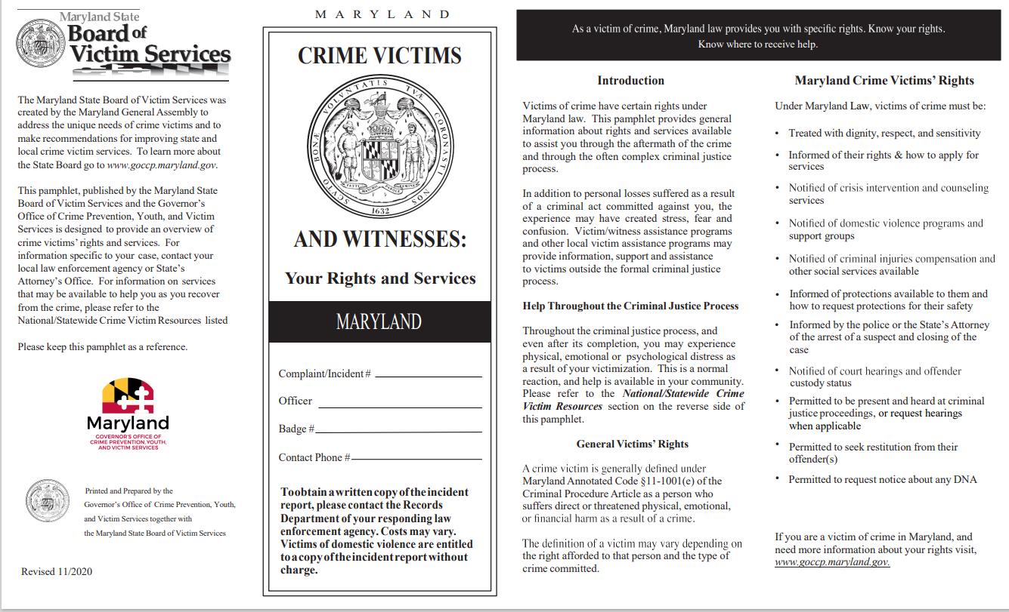
Victims Rights Under MD Law
“A victim of crime shall be treated by agents of the State with dignity, respect, and sensitivity during all phases of the criminal justice process.” MD Constitution, Declaration of Rights, Art. 47(a)
DocHdl1OnPPMSRVtmpTarget

Slide 5
Resources for Those Affected by Gun Violence and Homicide
Community Advocates Family & Youth (CAFY)
Maryland Crime Victim Resource Center (MCVRC)

Slide 6
Community Advocates Family & Youth (CAFY)
Victim Services & Case Management
Crisis management
Home visits
Assistance with paperwork
Referrals for services
Courtroom Accompaniment
Support Services
Individual counseling
Support groups
Legal Services
Family law issues
Immigration issues
Landlord/tenant issues
Protective orders
Community Services
Court education programs
Community workshops
Services for Seniors

Slide 7
Maryland Crime Victims Resource Center (MCVRC)
Victim Services
Assistance with paperwork
Referrals for services
Courtroom accompaniment
Legal representation
Support Services
Individual therapy
Support group for homicide survivors
Community & Organizational Training
Crime victim rights & laws
Best practices
Legislation
Policy advocacy

Slide 8
Resources for Those Affected by Domestic Related Gun Violence
Family Justice Center (FJC)

Slide 9
Family Justice Center (FJC)
Civil legal representation & immigration legal services
Court accompaniment
Crime victim rights
Criminal investigation & prosecution
Protection orders
Shelter referrals & safety planning
Crisis intervention & mental health services
Support groups
Forensic exams
HIV screening & wellness exams
Housing & financial assistance
Transportation assistance

Slide 10
Family Justice Center (FJC) Partner Agencies
Amara Legal Center
Bound for Better
BTST Services
Catholic Charities
CAFY
Courtney’s House
DV/SAC
Fair Girls
Family Crisis Center
House of Ruth
MD Crime Victims Resource Center
MD Legal Aid
PG Co. Sheriff’s Dept.
PG Co. Police Dept.
PG Co. Dept. of Family Services
PG Co. Dept. of Social Services
PG Co. Health Dept.
SALI
PG Co. SAO
Still I Rise
The NEHE Foundation
The Next Step
Women’s Law Center of MD

Slide 11
Resources for those Affected by Homicide
Roberta’s House
My Covenant Place

Slide 12
Roberta’s House
Family grief support center with locations in Baltimore & Hyattsville
Programs Available
Various support groups for adults, children & families
Groups/programs for parents who have lost a child
Bereavement camp for children
High-risk teen transformation program
School based programs & peer ambassadors
Community Outreach
Grief trainings & bereavement ministry training
Crisis response
Professional workshops

Slide 13
My Covenant Place
Individual counseling & support groups
In person or telehealth
Assessments & treatment plans
Anxiety, depression & night terrors
Trauma informed workshops
Yoga
Meditation
*Referrals to additional specialized services are also available

Slide 14

In a Nutshell…
Services provided by the Victim Services Program include referrals to both non-profit and state agencies for counseling, mental and emotional support, crisis intervention, legal aid, and financial assistance.
Victim Service Coordinators also guide individuals through the criminal justice process, explain their rights, help with protection orders, and ensure they receive information about case progress.
With the assistance of our Victim Service Coordinators, individuals can access the resources they need to help alleviate the immediate and long-term impacts of victimization.

Slide 15
What’s New & Forthcoming?
Homicide Brochure
Experience Camps Partnership
My Covenant Place Partnership
Grant Funding

Slide 16
Contact
Victim Services Coordinator:
Mrs. Nay Archie, MPS, CA, VASII
NRArchie@co.pg.md.us

