Slide 1

Truancy Pilot Program
A Collaborative Attack on the Truancy to Crime Pipeline
November 20, 2024

Slide 2
What is Truancy?
Definition & Terms

Slide 3
What is Truancy?
Truancy-
an act or instance of playing truant
the state of being truant
What is being truant?
one who stays out of school without permission
.

Slide 4
What is Truancy?
Key Terms when discuss truancy and overall attendance-
Absenteeism - Lawful or unlawful absence from school.
Lawful Absences - Include death in the immediate family, illness, pregnancy, court summons, hazardous weather conditions, work, observance of a religious holiday, state emergency, suspension, and lack of authorized transport.
Chronically Absent - Student is absent 10% of more of school says for
any reason
Including lawful and unlawful reasons
Habitually Truant - Unlawful absences for 20% or more of enrolled school days

Slide 5
What is Truancy?
Truancy in Maryland is defined as a student who is unlawfully absent from school for more than
8 days in any quarter
15 days in any semester or
20 days in a school year
Source: Chronic Absenteeism Trends and Bright Spots January 18, 2024 Presented by Carey M. Wright, Ed. D., Interim State Superintendent of Schools, Maryland State Department of Education

Slide 6
Effects of Truancy on Society and the Child

Slide 7
Factors that Contribute to Truancy
Factors that Contribute to Truancy-
Financial or medical needs
Violence near home or school
Bullying
Culture based attitudes toward education
Low academic achievement
Low Self Esteem or Bullying
Gang Involvement
Notes:
Truancy can be a Gateway to Crime (Examples)
Fiery Crash
J.T.-
On Wednesday, August 10, 2022, at approximately 0436 hours, patrol officers responded to the US Fuel in Clinton, Maryland for a stabbing. Public Safety Communications requested an ambulance, advising that the caller informed he was stabbed in the ribs and was now bleeding. Once on scene, officers located the caller and transported him to the hospital and the victim succumbed to his injuries. Video surveillance at the location captured the incident and the Respondent, JT was identified and located after a canvas of the area. During the respondent’s court case, his school records were requested. What did we learn? He was supposed to be enrolled in home school and his home school compliance papers were not up to date.
-
K.H.
On May 1st, 2023 at approximately 1655 hours Division IV patrol along with investigators responded to Neptune Avenue and Leverett Street, Oxon Hill, Prince George’s County, Maryland 20745 for the report of an assault. Once on scene, Investigators spoke to the victims. The victims advised that while riding a Prince George’s County Public School Bus, the school bus came to a stop at Iverson Street and Sutler Drive, when three suspects entered the bus and assaulted the victims. During the course of the investigation, all three suspects were identified. One of the suspects, K.H., had not been enrolled in school since 2019.
-
Schrom Hills.
This is the senior skip day shooting involving where two Bowie High School students shot five other students at a impromptu skip day event at Schrom Hills Park.
On April 19, 2024, the defendants were at the park with hundreds of other students from all over the county. For reasons that are still not clear, they pulled firearms and began firing into the crowd of students that were packed in between two buildings located at the entrance to the park. Police were in the parking lot preparing to break up the unsanctioned event when the shooting happened. Five juvenile victims were struck by gunfire and had to be taken to the hospital. Even though the police were present, the shooters were not identified on scene. After the incident, two separate witnesses were identified and gave statements identifying the shooters as the two defendants.
Please keep in mind that juveniles charged as adults records are confidential and may not be released unless and until a motion to transfer the case to juvenile is denied. So, while I can share this information internally, it should not be disclosed outside of this office and to certain law enforcement agencies. The defendants are Tristian Jackson, DOB 3/11/2008, and Didier Bifot, DOB 8/22/2009. Their cases are being submitted for indictment tomorrow. The attorney for Jackson is adamant that he was there but had nothing to do with the shooting. Probably one of the more interesting things about the case is that Didier Bifot, on the morning they served the arrest warrant told the police who woke him out of his bed that he wasn’t feeling well and was in a car accident the previous night. He ended up spending 3-4 weeks in Children’s National Hospital with very serious injuries. Him being arrested may have saved his life based on the extent of his injuries.

Slide 8
Truancy can lead to
Substance Abuse
Teen Pregnancy
Dropping out of school
Violence
Job Problems
Incarceration
Human Trafficking
Notes:
Truancy can be a Gateway to Crime (Examples)
Fiery Crash
J.T.-
On Wednesday, August 10, 2022, at approximately 0436 hours, patrol officers responded to the US Fuel in Clinton, Maryland for a stabbing. Public Safety Communications requested an ambulance, advising that the caller informed he was stabbed in the ribs and was now bleeding. Once on scene, officers located the caller and transported him to the hospital and the victim succumbed to his injuries. Video surveillance at the location captured the incident and the Respondent, JT was identified and located after a canvas of the area. During the respondent’s court case, his school records were requested. What did we learn? He was supposed to be enrolled in home school and his home school compliance papers were not up to date.
-
K.H.
On May 1st, 2023 at approximately 1655 hours Division IV patrol along with investigators responded to Neptune Avenue and Leverett Street, Oxon Hill, Prince George’s County, Maryland 20745 for the report of an assault. Once on scene, Investigators spoke to the victims. The victims advised that while riding a Prince George’s County Public School Bus, the school bus came to a stop at Iverson Street and Sutler Drive, when three suspects entered the bus and assaulted the victims. During the course of the investigation, all three suspects were identified. One of the suspects, K.H., had not been enrolled in school since 2019.
-
Schrom Hills.
This is the senior skip day shooting involving where two Bowie High School students shot five other students at a impromptu skip day event at Schrom Hills Park.
On April 19, 2024, the defendants were at the park with hundreds of other students from all over the county. For reasons that are still not clear, they pulled firearms and began firing into the crowd of students that were packed in between two buildings located at the entrance to the park. Police were in the parking lot preparing to break up the unsanctioned event when the shooting happened. Five juvenile victims were struck by gunfire and had to be taken to the hospital. Even though the police were present, the shooters were not identified on scene. After the incident, two separate witnesses were identified and gave statements identifying the shooters as the two defendants.
Please keep in mind that juveniles charged as adults records are confidential and may not be released unless and until a motion to transfer the case to juvenile is denied. So, while I can share this information internally, it should not be disclosed outside of this office and to certain law enforcement agencies. The defendants are Tristian Jackson, DOB 3/11/2008, and Didier Bifot, DOB 8/22/2009. Their cases are being submitted for indictment tomorrow. The attorney for Jackson is adamant that he was there but had nothing to do with the shooting. Probably one of the more interesting things about the case is that Didier Bifot, on the morning they served the arrest warrant told the police who woke him out of his bed that he wasn’t feeling well and was in a car accident the previous night. He ended up spending 3-4 weeks in Children’s National Hospital with very serious injuries. Him being arrested may have saved his life based on the extent of his injuries.

Slide 9
Truancy and Impact on Academic Success
Missing 10% (or about 18 days of a school year) can drastically affect a student’s academic success.
By the 6th grade, absenteeism is one of three signs that can indicate if a student is at risk for dropping out of high school. In the 9th grade, regular and high attendance predicts graduation rates better than 8th grade test scores.
Truancy and unexcused absences from school is a known risk factor for adult criminality and delinquent behavior.
Notes:
Truancy can be a Gateway to Crime (Examples)
Fiery Crash
J.T.-
On Wednesday, August 10, 2022, at approximately 0436 hours, patrol officers responded to the US Fuel in Clinton, Maryland for a stabbing. Public Safety Communications requested an ambulance, advising that the caller informed he was stabbed in the ribs and was now bleeding. Once on scene, officers located the caller and transported him to the hospital and the victim succumbed to his injuries. Video surveillance at the location captured the incident and the Respondent, JT was identified and located after a canvas of the area. During the respondent’s court case, his school records were requested. What did we learn? He was supposed to be enrolled in home school and his home school compliance papers were not up to date.
-
K.H.
On May 1st, 2023 at approximately 1655 hours Division IV patrol along with investigators responded to Neptune Avenue and Leverett Street, Oxon Hill, Prince George’s County, Maryland 20745 for the report of an assault. Once on scene, Investigators spoke to the victims. The victims advised that while riding a Prince George’s County Public School Bus, the school bus came to a stop at Iverson Street and Sutler Drive, when three suspects entered the bus and assaulted the victims. During the course of the investigation, all three suspects were identified. One of the suspects, K.H., had not been enrolled in school since 2019.
-
Schrom Hills.
This is the senior skip day shooting involving where two Bowie High School students shot five other students at a impromptu skip day event at Schrom Hills Park.
On April 19, 2024, the defendants were at the park with hundreds of other students from all over the county. For reasons that are still not clear, they pulled firearms and began firing into the crowd of students that were packed in between two buildings located at the entrance to the park. Police were in the parking lot preparing to break up the unsanctioned event when the shooting happened. Five juvenile victims were struck by gunfire and had to be taken to the hospital. Even though the police were present, the shooters were not identified on scene. After the incident, two separate witnesses were identified and gave statements identifying the shooters as the two defendants.
Please keep in mind that juveniles charged as adults records are confidential and may not be released unless and until a motion to transfer the case to juvenile is denied. So, while I can share this information internally, it should not be disclosed outside of this office and to certain law enforcement agencies. The defendants are Tristian Jackson, DOB 3/11/2008, and Didier Bifot, DOB 8/22/2009. Their cases are being submitted for indictment tomorrow. The attorney for Jackson is adamant that he was there but had nothing to do with the shooting. Probably one of the more interesting things about the case is that Didier Bifot, on the morning they served the arrest warrant told the police who woke him out of his bed that he wasn’t feeling well and was in a car accident the previous night. He ended up spending 3-4 weeks in Children’s National Hospital with very serious injuries. Him being arrested may have saved his life based on the extent of his injuries.

Slide 10
Truancy is a Crime Pipeline
Truancy can be a gateway to crime
High school dropouts are 8 times more likely to be incarcerated than people with high school diplomas (See Note for Source)
Examples
Fatal stabbing at US Fuel in Clinton on Wed 8/10/22 at ~4:36am. The Respondent's home school compliance documents were not up to date. (JT)
PGCPS school bus assault when 3 suspects boarded at stop in Oxon Hill on 5/1/23. One Suspect, KH, had not been enrolled in school since 2019. (Baby K)
5 students shot by 2 Bowie High School students during countywide unsanctioned impromptu Senior Skip Day at Strom Hill Park in Greenbelt on Fri 4/19/24. (TJ,DB)
.Source: PGCPS Chronic Absenteeism and Truancy: Truancy Study Workgroup 4/12/2024 Presentation.

Slide 11
Maryland State Stats & Law

Slide 12
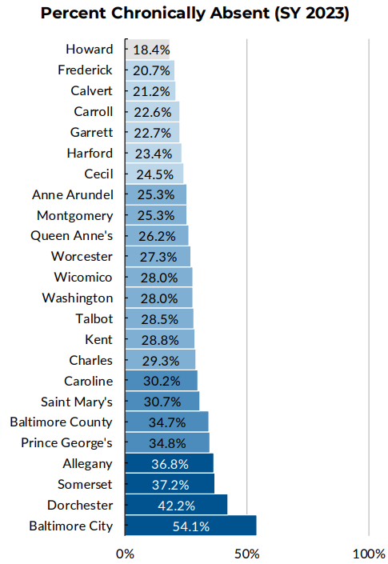
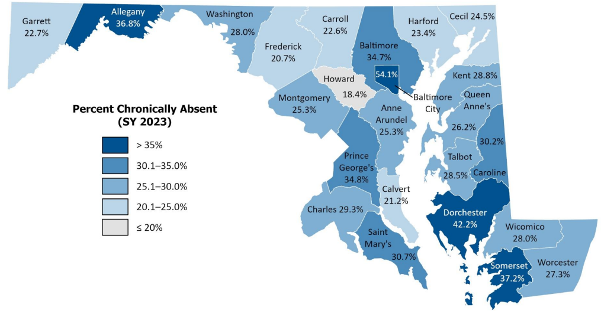
Maryland State Stats
Maryland Chronic Absenteeism by County Varied from 18% to 54% in SY23
Source: Chronic Absenteeism Trends and Bright Spots January 18, 2024 Presented by Carey M. Wright, Ed. D., Interim State Superintendent of Schools, Maryland State Department of Education

Slide 13
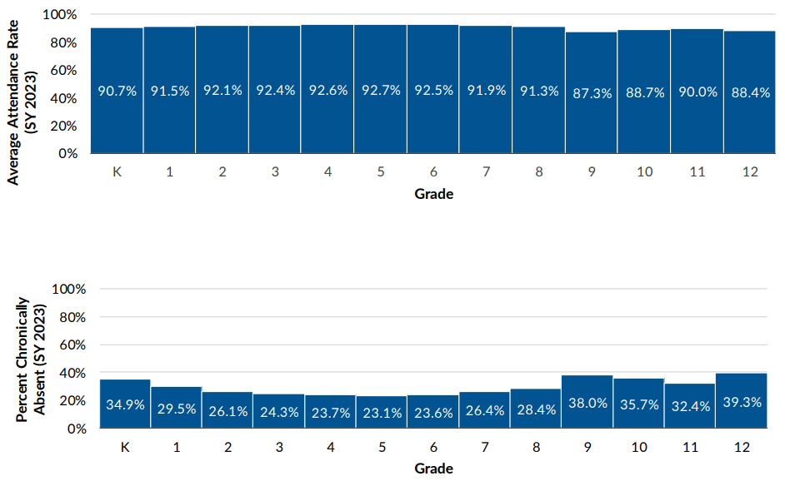
Maryland State Stats
Maryland State Attendance Trends by Grade (SY23)
Attendance rates were
Lowest in grade 9, closely followed 10 & 12, and
Highest in grade 5, closely followed by 3 ,4 and 6
Chronic Absenteeism were
Lowest in grade 5, closely followed by 6 & 4 and
Highest in grade 12, followed by 9. Grades 10 & 11 were also high.
Source: Chronic Absenteeism Trends and Bright Spots January 18, 2024 Presented by Carey M. Wright, Ed. D., Interim State Superintendent of Schools, Maryland State Department of Education

Slide 14
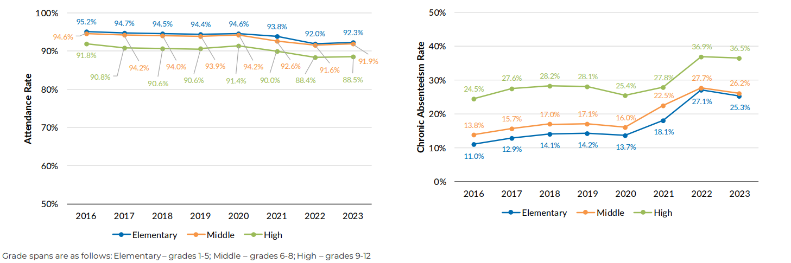
Maryland Stat Stats
State Trends in Attendance Rate & Chronic Absenteeism
Attendance rates have dropped up to 3% since 2016
Chronic Absenteeism increased by 10+%
Elementary & middle school attendance & chronic absenteeism rates are similar
Source: Chronic Absenteeism Trends and Bright Spots January 18, 2024 Presented by Carey M. Wright, Ed. D., Interim State Superintendent of Schools, Maryland State Department of Education

Slide 15
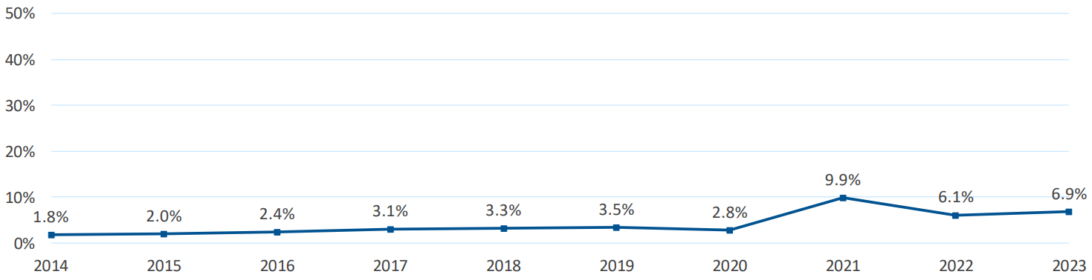
Maryland Stat Stats
State Habitual Truancy Trends
The habitual truancy rate for all students was 6.9% in school year 2022-2023.
Source: Chronic Absenteeism Trends and Bright Spots January 18, 2024 Presented by Carey M. Wright, Ed. D., Interim State Superintendent of Schools, Maryland State Department of Education

Slide 16
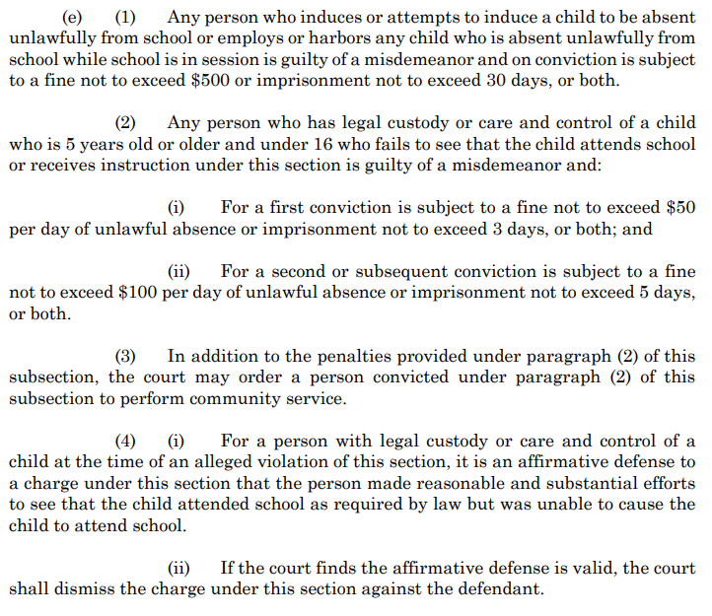
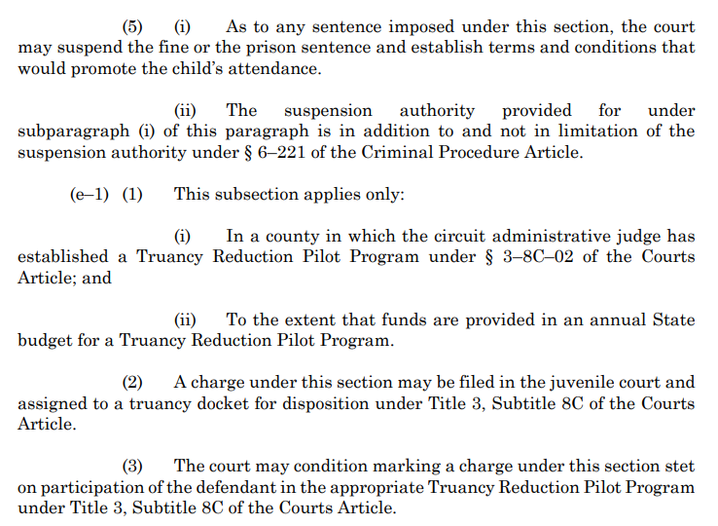



































Maryland State Law
Maryland Truancy Law can be found in the Education statute 7-301
Article - Education, Section 7-301 (maryland.gov)
Legal repercussions for parents may Include fines & imprisonment
.

Slide 17
Maryland State Law
Maryland Truancy Law can be found in the Education statute 7-301
Article - Education, Section 7-301 (maryland.gov)
Maryland law requires children between the ages of five and 16 to attend school, which may include homeschool or other non-public options. Families that decide to homeschool their children must follow the state's guidelines to ensure their children are receiving an adequate education.
Parents who do not comply with Maryland's compulsory education laws may be subject to fines and even jail terms.
.

Slide 18
Maryland State Law
Age at Which School Attendance is Required | Between 5 and 18
Exceptions to Attendance Requirements | Receiving other regular, thorough instruction in studies usually taught in public schools to children of same age group; mental/emotional/physical condition which makes his instruction detrimental to his progress or whose presence presents danger of serious physical harm to others
Home School Provisions | Receiving otherwise regular, thorough instruction in studies usually taught in public schools to children of same age group
Penalties on Parents for Noncompliance Defense | Guilty of misdemeanor; first conviction: subject to fine up to $50 and/or up to 3 days jail; subsequent conviction: fine of $100 and/or up to 5 days jail w possible community service. “reasonable and substantial efforts” were made
.

Slide 19
Efforts Made to Combat Truancy

Slide 20
Pandemic and Truancy
The Pandemic Greatly Impacted School Attendance
During the pandemic, our schools saw an increased issue with attendance.
In MD and Nationwide-
The percentage of students missing at least 10 percent of a school year—surged from 15 percent in 2018 to 28 percent in 2022.
Chronic absenteeism rates improved in 2023 but still remained 75 percent higher than the pre-pandemic baseline.
Chronic absenteeism increased for all district types, but rates were highest in districts with low achievement and higher poverty, affecting over one in three students.
.Source: American Enterprise Institute- Article - Long COVID for Public Schools: Chronic Absenteeism Before and After the Pandemic

Slide 21

Efforts to Combat Truancy
BACK TO SCHOOL EVENT-
To assist our partners in education, in September of 2021, SAO hosted the event Back to School- Back to Basics. At this event, stakeholders provided, school resources, opportunities for employment, and a presentation from One Love.

Slide 22
Efforts to Combat Truancy
JOINT LETTER and PSA-
To reinforce the messaging of school attendance, PGSAO and PGCPS partnered once again to pen a joint letter and filmed public service announcements.
State's Attorney Aisha Braveboy & PGCPS Chief Executive Officer Dr. Monica Goldson Discuss Truancy

Slide 23
Pilot Program

Slide 24
Planning Stages
Planning for the program began late 2022
Collaborative effort with PGCPS
Goals-
To streamline the current process so that we could get children back to school
Provide resources to parents – one-stop shop- wrap-around services

Slide 25
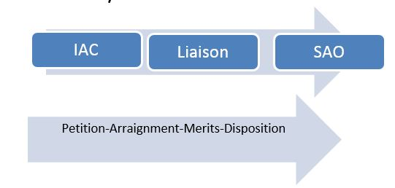
Truancy Traditional Truancy Flow Chart

Slide 26
Anti-Truancy Tentative Flowchart

Slide 27
Goals
Condensed IAC
Identify students and invite parents to a town hall meeting.
Educate parents (about the law and their student’s attendance).
Reconnect parents and students with their schools and staff.
Share information about services available to assist parents and students (provided resources- see next chart).
Afford families an opportunity to reconnect with the schools prior to petitioning the case to court.

Slide 28
Who answered the call to assist:
Resource Providers
Family Justice Academy
CINS and DJS
Adolescent Playhouse
Multisystemic Therapy Services
Truancy Reduction Court
FreeState
P31
Resilient Youth

Slide 29
Identified Schools and Dates for Programs
Anti-Truancy Pilot Program- Schools Identified
Since the school data is not available to SAO, the school system after reviewing data identified the schools.
Collaborating with the schools, we sent out letters to the parents informing them that their child was truant and invited them to an event to learn more about truancy, it’s effects, services to help the students & families, and the criminal process for combatting truancy.
Program started January 30th 2024
Bladensburg High School
Crossland High School
Drew Freeman Middle School
Suitland High School
Thurgood Marshall Middle School

Slide 30
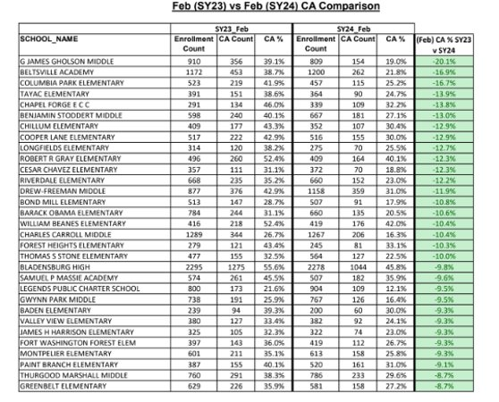
Prince George's County Stats
Year to Year Chronic Absenteeism Rate (Feb SY23 to Feb SY24)
.Source: PGCPS Chronic Absenteeism and Truancy: Truancy Study Workgroup 4/12/2024 Presentation

Slide 31
Attendance to the Pilot Program
Anti-Truancy Pilot Program- Schools Identified
Invited numbers:
Bladensburg HS - 137
Crossland HS - 102
Drew Freeman MS - 76
Suitland HS - 290
Thurgood Marshall MS - 35
Numbers attended: (includes families beyond the student and parent)
Bladensburg HS - 115
Crossland HS - 68
Drew Freeman MS - staff left system
Suitland HS - 199 includes Drew Freeman
Thurgood Marshall MS - 8

Slide 32
Pilot Program-Truancy Case Filed
61 Cases Reviewed
56 Defendants (includes parents with multiple cases/families)
Dispositions-
Deferred Dispositions- 3
Writs- 11
Stets- 18
Pending- 16
Dismissals/DTP- 8

Slide 33
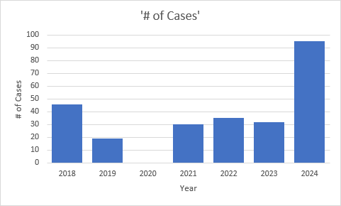
Truancy Cases Filed
Number of Cases that PGSAO Petitioned over the years
Year # of Cases
2018 46
2019 19
2020 0
2021 30
2022 35
2023 32
2024 95
Notes:
Number of truancy cases filed to date

Slide 34
Examples of Attendance Records
When the cases were referred to the program many of the students had missed over 25 days of school:
Student | Absences
J | 29
L | 28.5
R | 26
B | 34.5
A | 63.5
V | 42.5
G | 29
J | 60

Slide 35
Next Steps

Slide 36
Next Steps
Evaluating our process (grows and glows).
Prosecute cases from the program and IAC process.
Follow up with identified schools
Continue to support our PPW and educators.

Slide 37
Next Steps
Make the Truancy Pilot Program the standard throughout the county
An efficient collaborative process with a streamlined truancy referral process
Supports the school system, parents and students
Provides resources to students & their families
Notify families when a student's absences from school are problematic
We want to close the gateway from truancy to crime
Compliance - Children in schools and not in courts and receiving the education that they are entitled to by law.
Create productive citizens who positively enhance the community vs a schools to prisons pipeline
Notify stakeholders quickly when students are not going to school
.

Slide 38
Next Steps
Analyze the Truancy Pilot Program
Collaborate with the schools and other stakeholders to extend the rollout of the Truancy Pilot Program to additional high schools and middle schools
Work with the stakeholders to simplify the formula to calculate school days missed.
Create a simplified process to manage truancy
Example:
Trigger Action
5 days missed w/o notification Letter to parents
7 days missed Invitation to TPP event/intervention
10 days missed Case referred to SAO to be petitioned
The goal is not to give parents a criminal record.
Our goal is to get the students in compliance.
.
Notes:
Analyze the Truancy Pilot Program
Lessons Learned:
What worked?
What should we do differently?
Identify the Reduction in Truancy by Total # and %
Work with the Stakeholders to Simplify the Formula to Calculate School Days Missed.
Maybe Count Missed Days of School like we do Missed Days of Work.
At work, if a person misses 3 days there is corrective action. Maybe with students, 5 days or 7 days of school missed is the 1st Trigger.

Slide 39
Next Steps
Get creative with obtaining resources to assist PPWs
Example: Use college and grad students who need internships, externships, practicums, etc. to work with the PPWs to help implement the revised, simplified truancy process.
Students get school credit
Can be paid or unpaid positions
Paid positions can be grant funded positions.
Majors could include social work, psychology, etc.
Recommend legislative priorities to change or add laws to help reduce truancy
Identify the common causes for truancy and
Identify services and programs that can help resolve the issues
Talk to DJS about the services that they offer and include them with the
Truancy Pilot Program
.

Slide 40
Next Steps
Participate in all high school & middle school Back to School Programs and share information about the Truancy Pilot Program
Video announcements from stakeholders
School Super Intendent
State’s Attorney
.

Slide 41
Takeaways
Parents need assistance and check-ins
Many were embarrassed to learn their children were not attending school.
Some required support in getting the child to stay at school.
Children openly apologized and committed to going back to school.
A gentle reminder from SAO with PGCPS by their side encouraged folks to reengage with their schools.

Slide 42
Takeaways
Key to a successful Anti-Truancy Initiative
Parent/Guardian Involvement
School Leadership
Community Support
Effective Legal Action

Slide 43


PLEASE STAY SAFE AND HEALTHY!
Connect With Us!
Website: pgsao.org| @pgsaonews

