Slide 1
The Bridge Center at Adam’s House
Prince George’s County Health Department
Behavioral Health Division

Slide 2

Bridge Center at Adam’s House
One-stop shop providing wrap-around health and human services to:
Returning Citizens
Transitional Aged Youth (18-24)
Veterans
Collaboration between Health Dept, Dept of Social Services, and Dept of Family Services
Over 30 community-based partners
“No wrong door” approach
5001 Silver Hill Road
Suite 300
Suitland, Maryland
301-817-1900
bridgecenter@co.pg.md.us

Slide 3
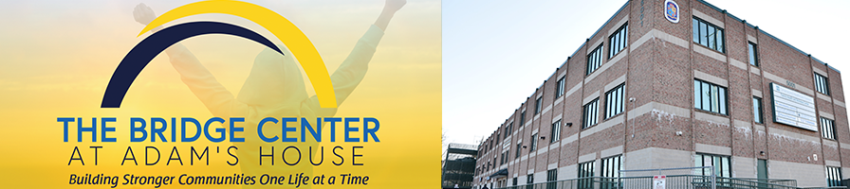
Employment Assistance
Job Training
Veterans Affairs & Claims Assistance
Court Ambassadors
Child Support Assistance
Food Assistance
Medical Insurance Assistance
GED/College Enrollment Assistance
Youth & Teens Services
Mental Health Services
Family Reunification Services
Substance Abuse Treatment
Transportation Assistance
Legal Assistance
ID Assistance
Birth Certifications
Re-entry Support Program
Case Management
Peer Support
Anger Management Courses

Slide 4
Community Partners
Catholic Charities
National Association for Black Veterans
Maryland Health Connection
Mettle Works Behavioral Health
Damascus House
The Denney House
Destiny, Power, and Purpose
DXT Therapeutic Services
Community Legal Services
A Father’s Place
MISO Medical Center
Community Choice Health
DSW & Associates
Eckerd Connects
Employ Prince George’s
House of Samaria
Kirstin Care
MD Reentry Resource Center
MAT Clinics
Men in the Gap
New Mindz
Restoration Center
Industrial Banking
Food 4 Thought
Dreams Work
Greater Baden Medical Services

Slide 5
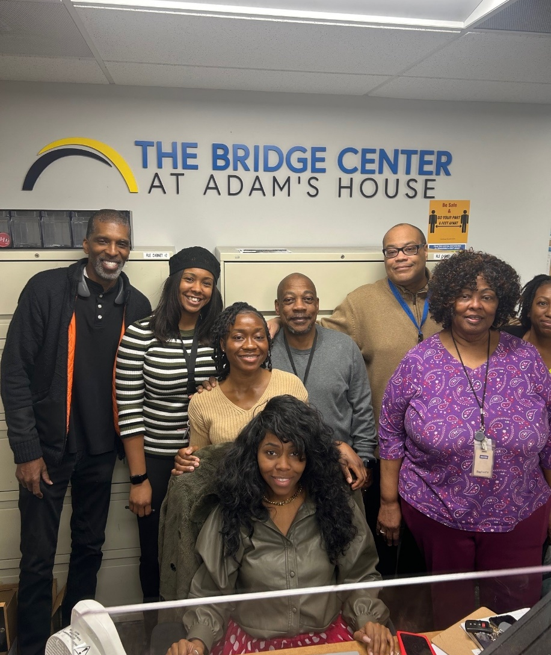
Bridge Center Impact
FY24 active clients across all programs: 1,129
FY24 walk-ins: 1,091
Total persons served in FY24: 2,220
Number of active clients arrested for a new offense in FY24: 5
Less than 1% recidivism rate, compared to the county rate of ~22%

Slide 6
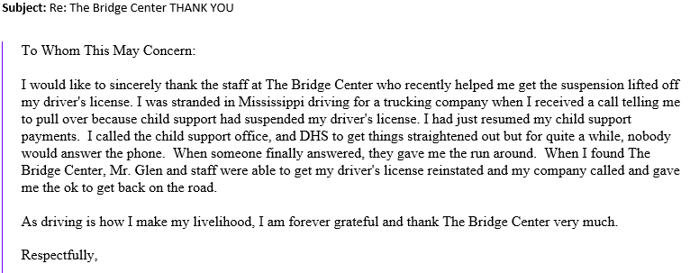
Client Feedback

Slide 7
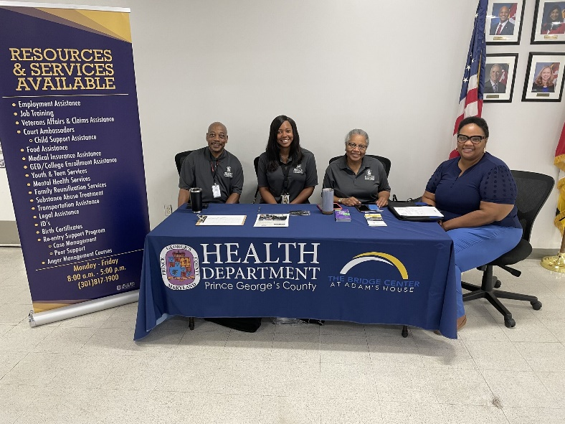
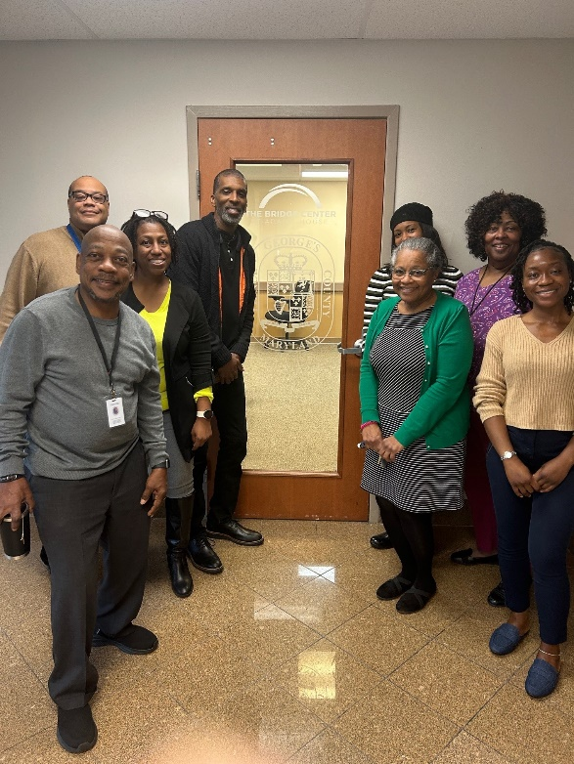
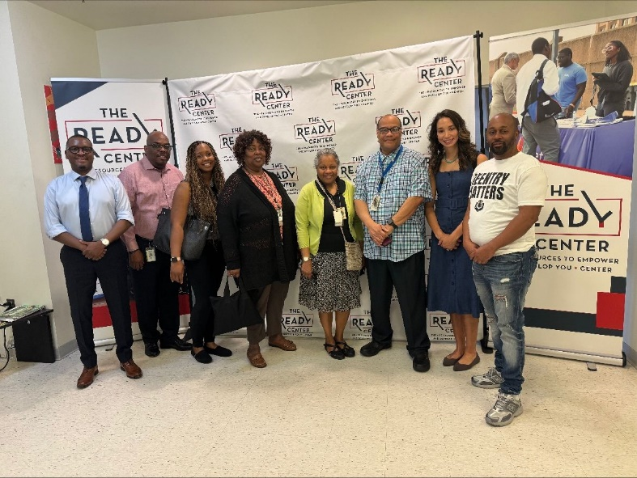
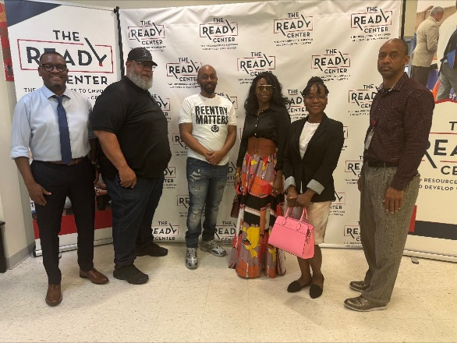
Community Collaborations

Slide 8
Assessment and Case Management
Partnership with Department of Parole and Probation
Transitioned into collective impact model
MOUs with five (5) community providers
Mental Health Reentry Counselor in Detention Center
Support of funding partners; GOCPP

Slide 9
Peer Recovery Initiatives
Peer Training Curriculum
MD Peer Certification requirements
Four domains of peer recovery
Reentry Peer Support Program
Adult SUD Peer Recovery Program

Slide 10
Questions?
Get in touch:
Bridge Center
5001 Silver Hill Road, Suite 300
Suitland, MD
301-817-1900
bridgecenter@co.pg.md.us
Nina Ward, Program Chief, Behavioral Health Division
240-484-2052
nbward@co.pg.md.us

