Slide 1


Sasha Bruce Youthwork

Slide 2

THE MISSION OF SASHA BRUCE YOUTHWORK IS TO IMPROVE THE
LIVES OF RUNAWAY,
HOMELESS AND
AT-RISK YOUTH
AND THEIR FAMILIES
IN THE WASHINGTON DC AREA.

Slide 3
The History of Sasha Bruce Youthwork, Inc.
Deborah Shore founded Sasha Bruce Youthwork in 1974 as the Washington Streetwork Project. The focus of the organization’s early work was to help young people sort out what brought them to the streets and try to get them reconnected at home.
In 1976, Shore and the Washington Streetwork Project came to the attention of Evangeline Bruce, wife of Ambassador David Bruce, following the tragic death of their daughter Sasha. Evangeline Bruce donated funds to start a youth shelter in memory of Sasha, who had helped troubled youth as a volunteer when she was in school. Shore opened Sasha Bruce House in 1977 to provide homeless kids a safe haven from the dangers of the streets.
The Washington Streetwork Project grew and changed over the next two decades in response to the changing needs of DC’s troubled young people and families. Programs were added to bridge the gaps in available support services for youth. As street work became only a small part of the organization’s activities, the name of the organization changed to Sasha Bruce Youthwork.
Today Sasha Bruce Youthwork is one of the largest and most experienced providers of services to youth in Washington, DC.

Slide 4
Target Population
Youth 12-24 years old with a special focus on transitional-age youth
Minor Youth
Homeless and Runaway
System-Involved (Juvenile Justice and Child Welfare)
‘At-Risk’ Young People in Public Schools and Public Housing
Youth Ages 18-24
Homeless or Housing Insecure
Disconnected from Education & Work
Disconnected from Family/Fragile Relationships

Slide 5
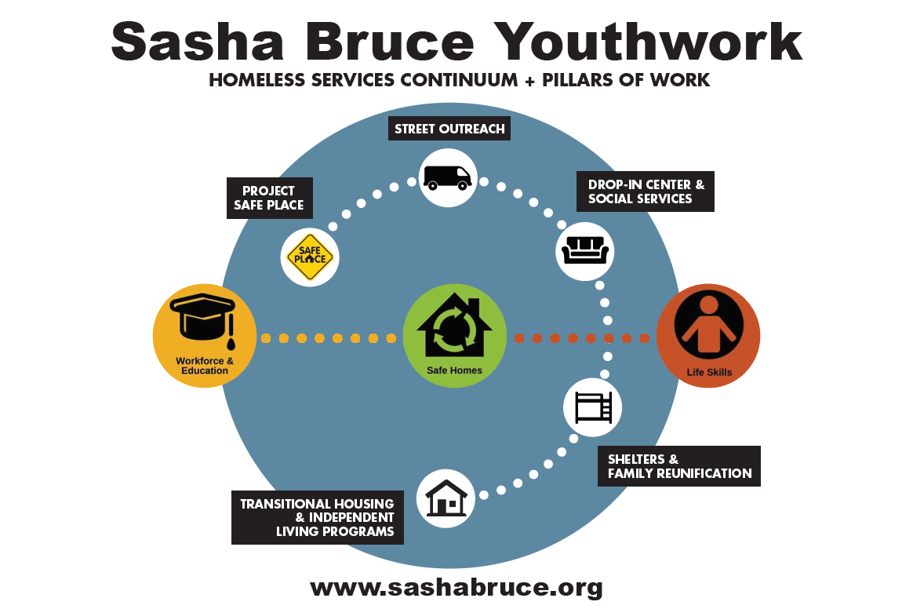

Slide 6
SBY Continuum of Support Safe Homes Pillar
8th Street Drop In Center + Pop Up Drop In Centers in Chinatown/Gallery Place; Prince George’s County Drop In Center
Street Outreach
Housing for Youth in the Juvenile Justice System in the Chloe and REACH Houses
Emergency Shelter for Homeless Youth 12-17 at Bruce House and 12-24 at Promise Place
Emergency, 90 Day Shelter, 18-24 Year olds at Philip Reid
Independent Living Programs including for Young Moms and their Children at Olaiya’s Cradle
Transitional Living Program for Families (Parents 18-24) at THP
Transitional Living and Extended Transitional Living Programs for Individuals at ILP, TLP and Passages; Philip Reid
Transitional and Rapid Rehousing Through Thrive
Housing for CFSA Involved Youth at Allen House
Incoming: housing for CFSA Involved, Pregnant and Parenting Youth

Slide 7
SBY Continuum of Support Life Skills Pillar
Substance Abuse Prevention through the DC Wards 5&6 Prevention Center
Family Stabilization and Reunification Services through FSP/CARES
Community and Family Wrap Around Services at the Clay Terrace Family Success Center
Intensive Mentoring and Case Management Services for DYRS-Involved Youth with the SBY Credible Messenger Program
Child Trends, Youth-Led Violence Research Project
Behavioral Health Services via CareFirst

Slide 8
SBY Continuum of Support Workforce and Education Pillar
College and Career Program
Lukey Kaempfer Transformation Project (current clients)
OST Programming at Phelps High School/Ballou
Jerry M Contempt Fines Project: Resilient Scholars Program

Slide 9
Focus: Bruce empowerment Zone Drop In Center
Location:
7723 Barlowe Rd, Hyattsville MD 20785
Schedule:
M, T, W, Th, F: 9-6 pm,
How to get in touch? Come in person!
Youth Ages 14-24, Homeless or Housing Insecure
What services will youth receive?
Basic survival needs - food, a place to sleep for a while, etc.
Case management
Housing navigation including emergency housing
Support navigating public benefits and vital records
And more!

Slide 10
Focus: Street Outreach Program
Targeted outreach in youth friendly areas as well as transportation hubs, libraries, hospitals, etc.
Age Range: 14-24
Focus is on harm reduction planning, connection to shelter and/or BEZ DIC and getting clients out of literal street homelessness

Slide 11
Bruce Empowerment Zone
The Bruce Empowerment Zone is a no-barrier drop-in center with supportive services and mobile street outreach in Prince George’s County that serves youth and young adults (YYA) up to the age of 25 who are homeless or unstably housed. Established in 2021,
Sasha Bruce Drop-in Center Also Known as the Bruce Empowerment Zone works to reduce the length of time that a young person aging from 14-24 experience Homelessness in Prince George’s County region.
The BEZ Drop-in Center fosters a safe and trusting environment where youth receive care and empowerment.

Slide 12
Bruce Empowerment Zone
In addition to providing survival services, BEZ supports youth in their Journey toward stable housing and economic independence.
We provide a vital safe space for young people facing homelessness. With a focus on supporting Latino and LGBTQ+ communities. BEZ offers essential resources to help young people find stability and hope.
We aLso provide an array of services such as: homeless Prevention, emergency/ transitional Housing assistance, Resume Building, School/ Employment/ Military placement assistance, Peer support, empowering Groups and counseling, Money management, Hygiene Supplies, Food and hot meals, Clothes, Transportation, Baby supplies, State benefits, vital records, and an onsite computer lab.

Slide 13
Resilience Project Overview
A plan to prevent homelessness among youth in Prince George’s County, Maryland (PGC) through a collaboration between Sasha Bruce Youthwork, a leader in services to youth experiencing homelessness across the District of Columbia and PGC. SBY BEZ will undertake 6 months of prevention planning, following which we will identify and assess youth at-risk of homelessness, introduce flexible cash assistance and case management, and provide individualized and optional prevention services. We will monitor progress and report on outcomes developed through the planning process and in coordination with FYSB. All services will promote equity and be driven by youth with lived experience of homelessness.

Slide 14
Resilience Project :
Needs to be Addressed
PGC is the largest county in Maryland with a large proportion of BIPOC and non-citizen immigrant youth. LGBTQ+ youth lack specific supports and safe, affirming spaces in the county. Youth in targeted areas in the county experience housing insecurity, poverty, failure to graduate high school, behavioral health issues, family conflict and involvement with the child welfare and juvenile justice systems, all of which disproportionately affect BIPOC youth.

Slide 15
Resilience Project: Functions
All services are provided through a lens of trauma-informed care that emphasizes physical, psychological and emotional safety. Staff are highly trained in issues relevant to homeless youth and receive monthly clinical support. Our organizations have the capacity and the structure to manage this project, with a strong administration, well-coordinated services, and a development and communications team to address funding shortfalls or unforeseen needs.

Slide 16
Resilience Project: programming offered to enrolled clients
Coaches contact clients at a minimum of once a week to set their service plan/goals.
Communication may include face to face contact, phone call, text message exchanges, emails and virtual meetings.
Regular coaching sessions with Resilience Coach
Support with goals
Financial budgeting and literacy programming including monthly budgeting sessions
Peer activities and groups
Life skills groups
Referrals to services and outside partners
Basic services such as meals, hygiene supplies and more
Access to AFFIRM counseling sessions if relevant

Slide 17
Conclusion
In addition, the launch of the Resilience Project will provide focused support for 30 at-risk youth, ensuring they receive financial aid, coaching, and community resources. Together, BEZ and the Resilience Project are creating brighter futures for those who need it most. 🏳️‍🌈🏳️‍⚧️

