Slide 1

PRINCE GEORGE’S COUNTY POLICE DEPARTMENT
CGIG
Juvenile Statistics
Deputy Chief Z. O’Lare

Slide 2
CGIC
March 2024
Within Major Crimes Division
3 Sergeants, 16 Investigators
ATF, Gun Intel, Homicide

Slide 3
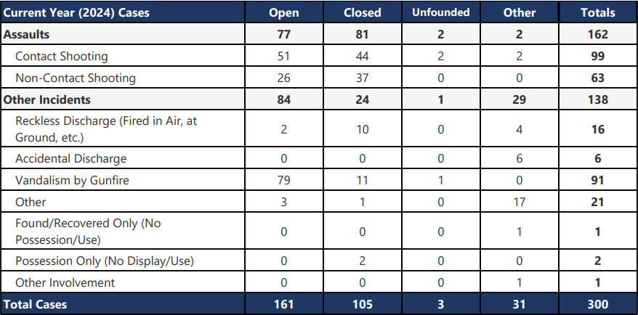
CGIC

Slide 4

CGIC

Slide 5
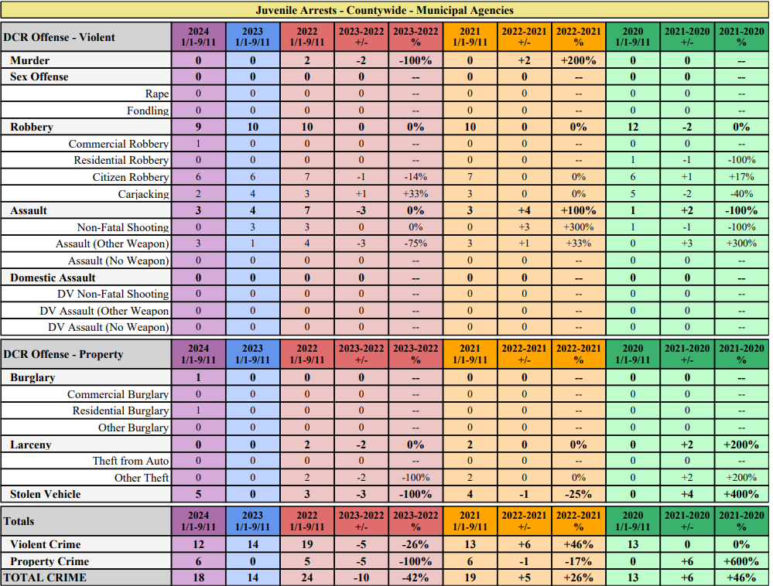

Slide 6
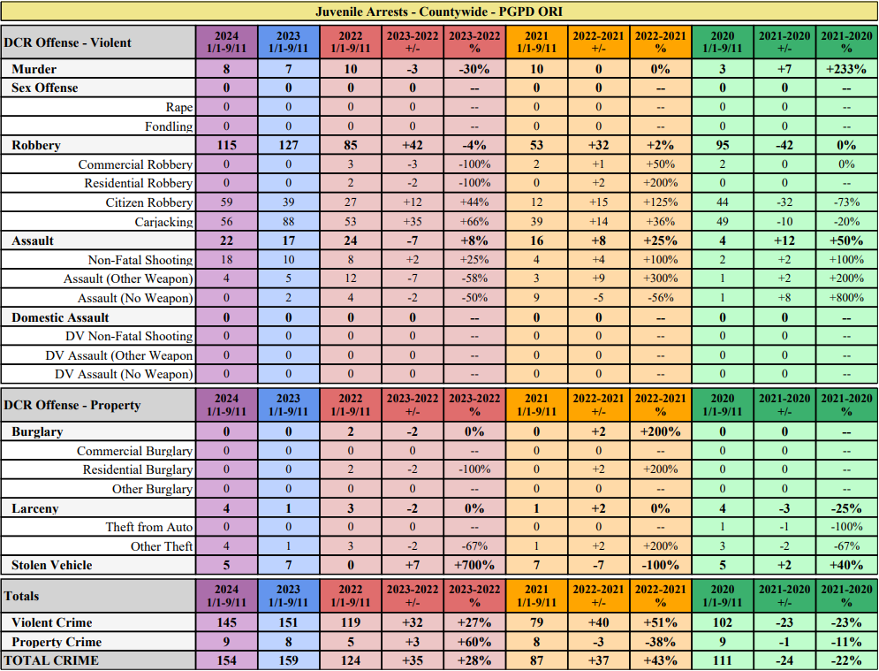

Slide 7
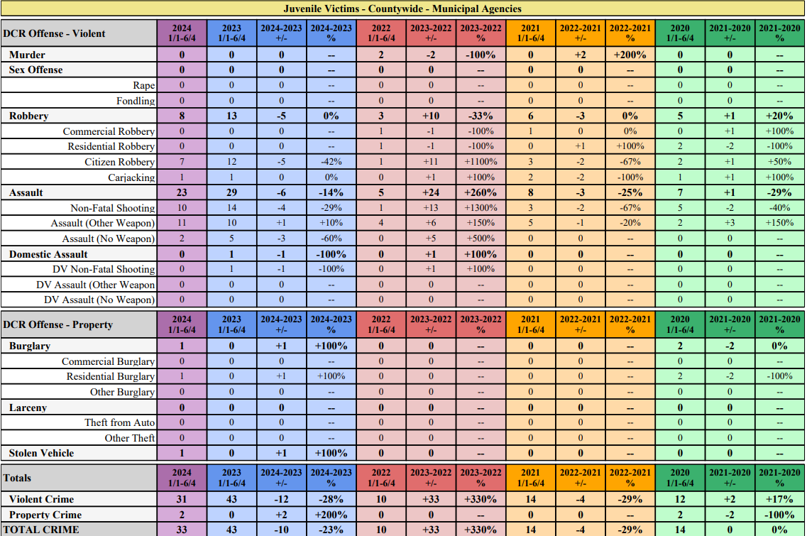

Slide 8
